Slide 1
Econometrics 871 Time Series
Topic 4
Trends and Unit Roots

Slide 2
Plan
Examples of the concern
The two types of non-stationarity
Definition
Simple Cases
Dangers
Removing non-stationarity: Detrending, Differencing, Filtering
Testing for unit roots
ACF, PACF
Dickey Fuller Tests and Variants

Slide 3
Time Series Models
Stationary
Non-Stationary
Univariate
Multivariate
Univariate
Deterministic Trends
Stochastic Trends
Filters
Differencing
Only E(y_{t}): ARMA(p,q)
E(y_{t}) & Var(y_{t}): ARCH
Multivariate
Cointegration / VECM
Tests
Detrending

Slide 4
Definitions
Weakly stationary process
Time independent expectation, variance and covariance
Trends and/or Unit roots:
Cases of time dependent moments

Slide 5
Key Questions:
How to identify non-stationarity:
Specifically, the type of non-stationarity
Given some type of non-stationarity:
How to correctly “deal with” the non-stationarity
Remove it? Or
Model it?

Slide 6
Non-Stationarity
Many macro series
Increase exponentially in levels/linearly in logs OR
Appear to wander without apparent mean reversion

Slide 7
The Issue

Slide 8
The Issue

Slide 9
Non-Stationarity
Many macro series
Increase exponentially in levels/linearly in logs OR
Appear to wander without apparent mean reversion
This has a dramatic impact on the properties of estimators and statistical tests
Standard classical results apply to stationary processes asymptotically
But do very poorly in small samples when series are highly persistent
“do poorly” here means that the size of the test is not what is predicted
Very different statistical results apply in small and large samples if processes are non-stationary, specifically if they have unit roots

Slide 10
Two Types of Non-Stationarity
“Trend Stationary”
Stationary process around a deterministic trend
Trend is deterministic function of time
ARMA + f(t)
“Difference Stationary”
Trend is stochastic
Random Walk
Trend has a stochastic and a deterministic component
Random Walk with Drift
Random Walk with Drift and Noise
ARIMA(p,d,q) with d=1 or 2 (usually)
These are called “integrated processes” or processes with a unit root
Philosophical considerations:
What types of non-stationarity make sense as an economic concept?
Forever? remember, most hypothesis tests are only valid asymptotically

Slide 11
“Dealing with” the Trend
“Dealing with” = getting rid of
Mostly applicable Univariate situation
Strongly related to the univariate tests we will consider
Risky
Can throw away information
Can “create” false information
Methods/Approaches:
Detrending
Differencing
Filtering (later) e.g.
Hodrick-Prescott filter
Band-Pass filter
Kalman filter

Slide 12
“dealing” with a trending series
Univariate approaches:
Deterministic trend = trend stationary process
Detrending is the correct approach
What happens if you difference a process with a deterministic trend?
Stochastic trend = difference stationary process
Differencing is the correct approach
What happens if you detrend a process with a stochastic trend?
Multivariate approach
Model the trend as part of the system with an economic, theoretical motivation as to the origin of the trend
In my view, the only correct approach if the purpose is using structural economic insights – topic 5: Cointegration

Slide 13
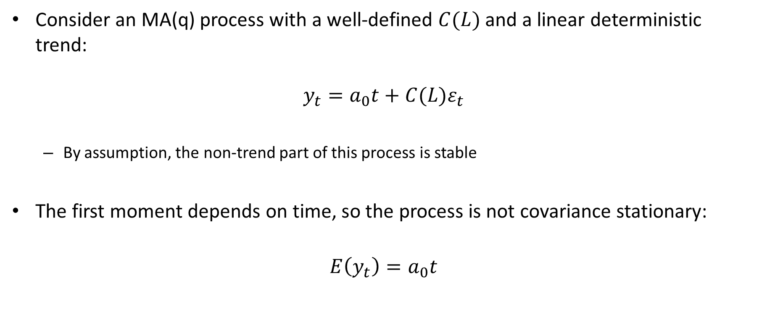
Trend Stationary Processes
Consider an MA(q) process with a well-defined $C(L)$ and a linear deterministic trend:
$$y_{t}=a_{0}t+C(L)ε_{t}$$
By assumption, the non-trend part of this process is stable
The first moment depends on time, so the process is not covariance stationary:
$$E\left(y_{t}\right)=a_{0}t$$

Slide 14
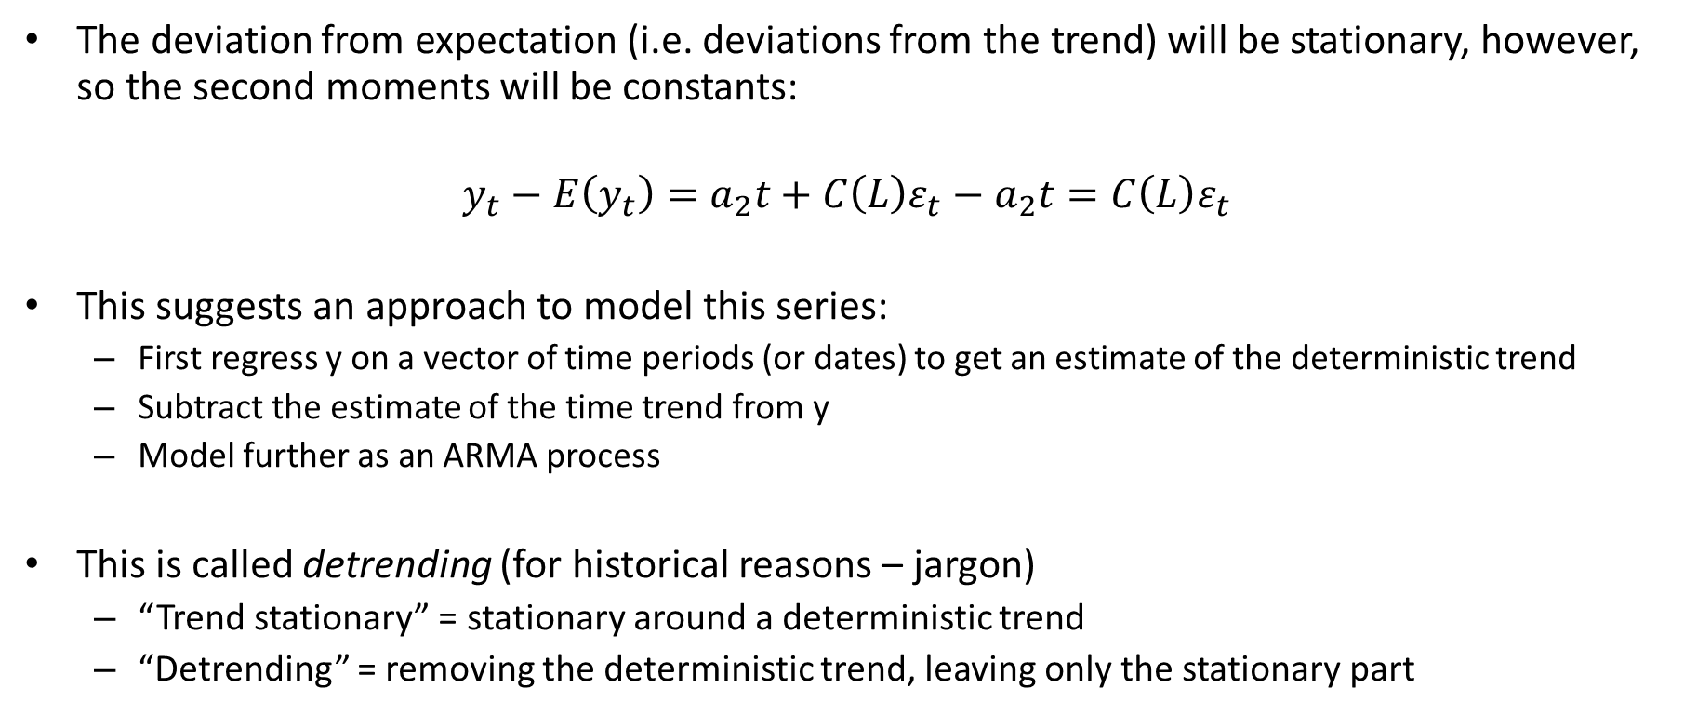
Trend Stationary Processes
The deviation from expectation (i.e. deviations from the trend) will be stationary, however, so the second moments will be constants:
$$y_{t}−E\left(y_{t}\right)=a_{2}t+C\left(L\right)ε_{t}−a_{2}t=C\left(L\right)ε_{t}$$
This suggests an approach to model this series:
First regress y on a vector of time periods (or dates) to get an estimate of the deterministic trend
Subtract the estimate of the time trend from y
Model further as an ARMA process
This is called detrending (for historical reasons – jargon)
“Trend stationary” = stationary around a deterministic trend
“Detrending” = removing the deterministic trend, leaving only the stationary part

Slide 15
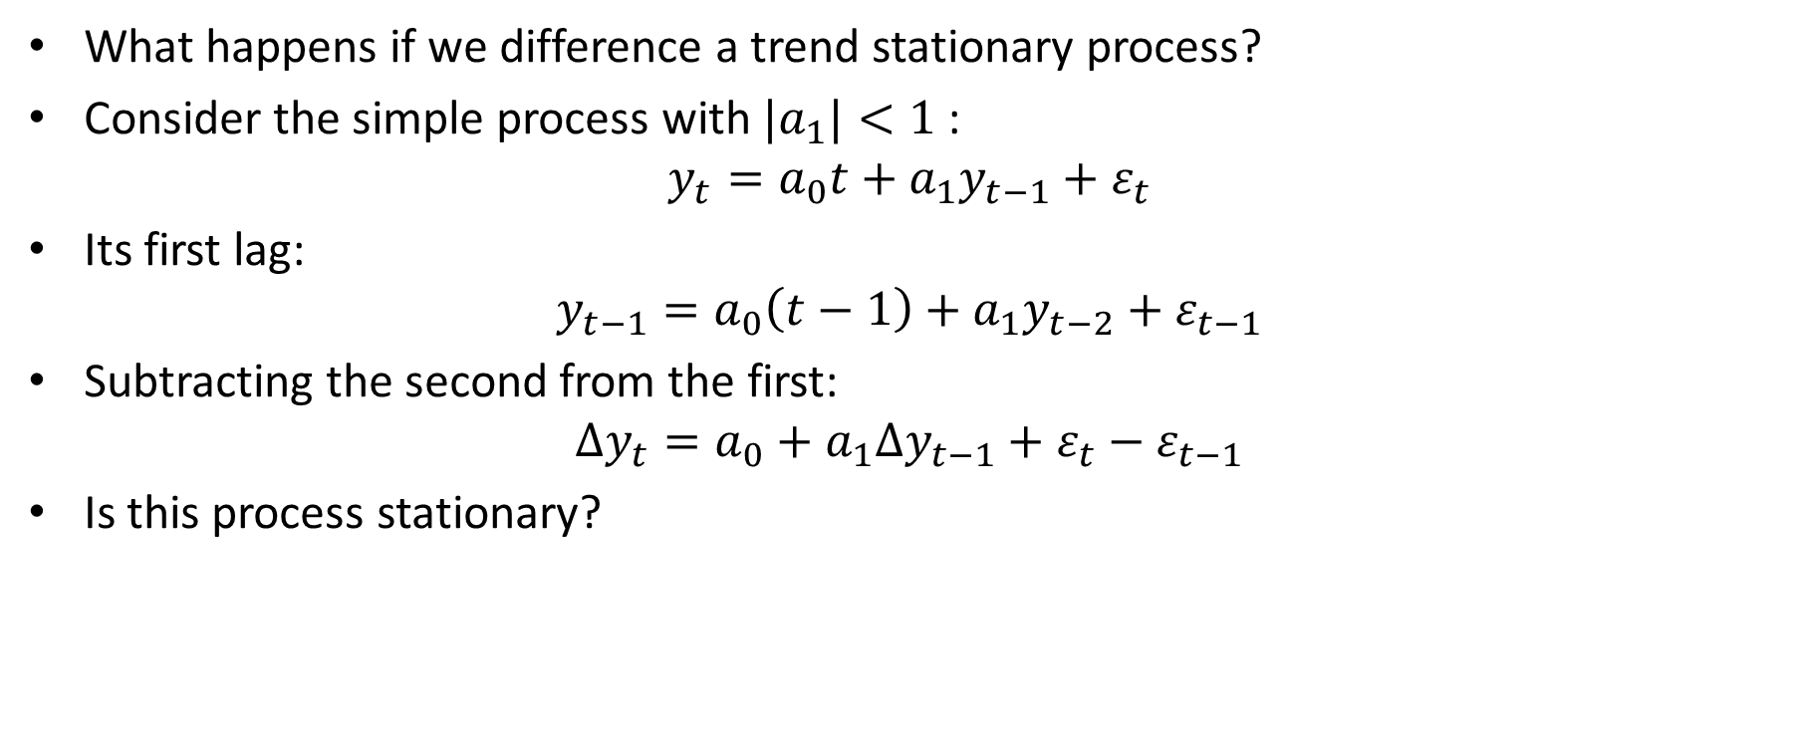
Trend Stationary Processes
What happens if we difference a trend stationary process?
Consider the simple process with ${|a}_{1}|<1$ :
$$y_{t}=a_{0}t+a_{1}y_{t−1}+ε_{t}$$
Its first lag:
$$y_{t−1}=a_{0}\left(t−1\right)+a_{1}y_{t−2}+ε_{t−1}$$
Subtracting the second from the first:
$$∆y_{t}=a_{0}+a_{1}∆y_{t−1}+ε_{t}−ε_{t−1}$$
Is this process stationary?

Slide 16
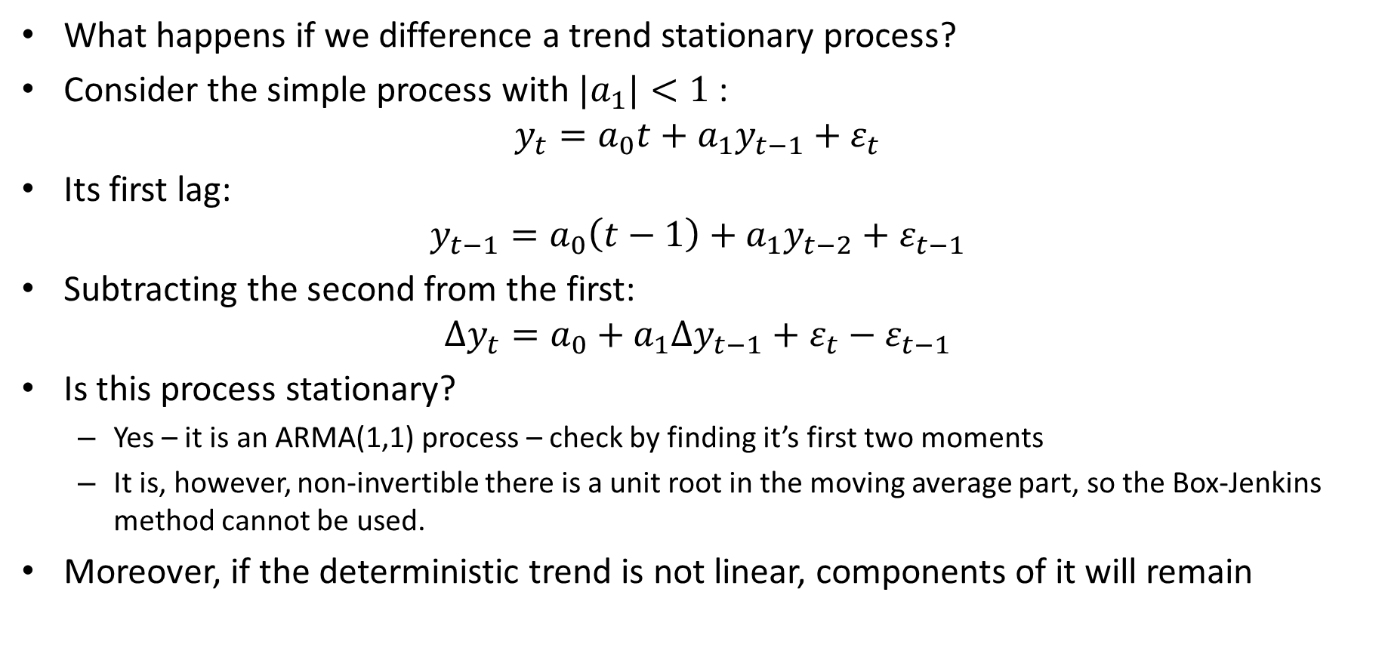
Trend Stationary Processes
What happens if we difference a trend stationary process?
Consider the simple process with ${|a}_{1}|<1$ :
$$y_{t}=a_{0}t+a_{1}y_{t−1}+ε_{t}$$
Its first lag:
$$y_{t−1}=a_{0}\left(t−1\right)+a_{1}y_{t−2}+ε_{t−1}$$
Subtracting the second from the first:
$$∆y_{t}=a_{0}+a_{1}∆y_{t−1}+ε_{t}−ε_{t−1}$$
Is this process stationary?
Yes – it is an ARMA(1,1) process – check by finding it’s first two moments
It is, however, non-invertible there is a unit root in the moving average part, so the Box-Jenkins method cannot be used.
Moreover, if the deterministic trend is not linear, components of it will remain

Slide 17
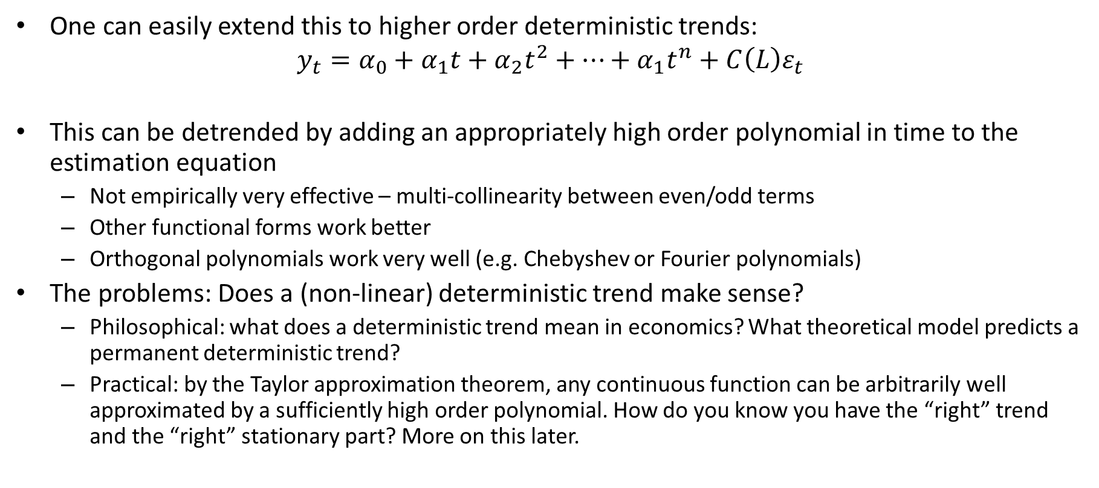
Trend Stationary Processes
One can easily extend this to higher order deterministic trends:
$$y_{t}=α_{0}+α_{1}t+α_{2}t^{2}+…+α_{1}t^{n}+C\left(L\right)ε_{t}$$
This can be detrended by adding an appropriately high order polynomial in time to the estimation equation
Not empirically very effective – multi-collinearity between even/odd terms
Other functional forms work better
Orthogonal polynomials work very well (e.g. Chebyshev or Fourier polynomials)
The problems: Does a (non-linear) deterministic trend make sense?
Philosophical: what does a deterministic trend mean in economics? What theoretical model predicts a permanent deterministic trend?
Practical: by the Taylor approximation theorem, any continuous function can be arbitrarily well approximated by a sufficiently high order polynomial. How do you know you have the “right” trend and the “right” stationary part? More on this later.

Slide 18
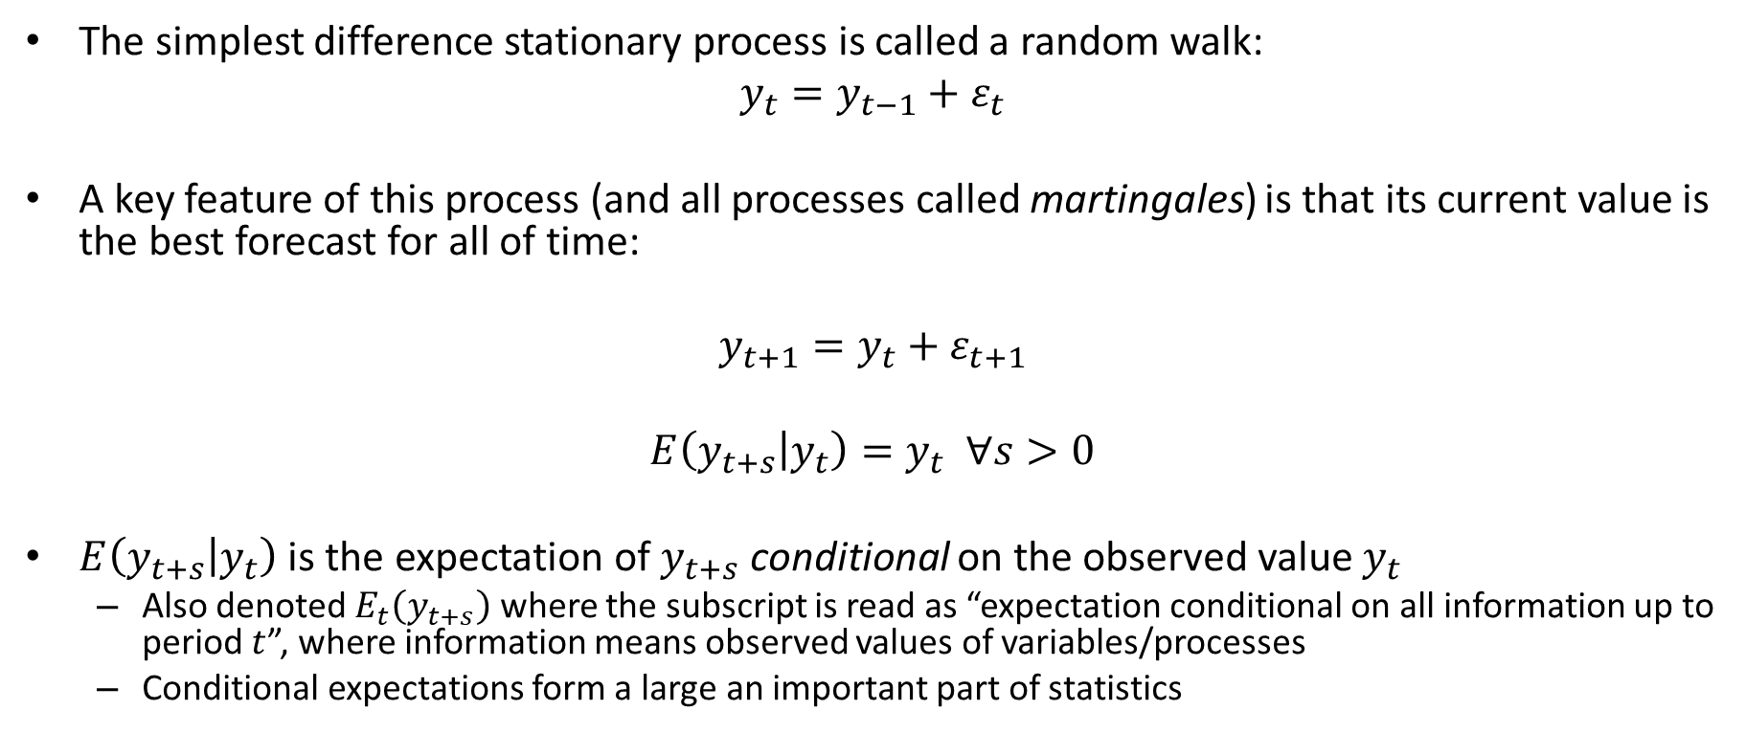
Difference Stationary Processes
The simplest difference stationary process is called a random walk:
$$y_{t}=y_{t−1}+ε_{t}$$
A key feature of this process (and all processes called martingales) is that its current value is the best forecast for all of time:
$$y_{t+1}=y_{t}+ε_{t+1}$$
$$E\left(y_{t+s} | y_{t}\right)=y_{t} ∀s>0$$
$E\left(y_{t+s} | y_{t}\right)$ is the expectation of $y_{t+s}$ conditional on the observed value $y_{t}$
Also denoted $E_{t}\left(y_{t+s}\right)$ where the subscript is read as “expectation conditional on all information up to period $t$”, where information means observed values of variables/processes
Conditional expectations form a large an important part of statistics

Slide 19

Difference Stationary Processes
The simplest difference stationary process is called a random walk:
$$y_{t}=y_{t−1}+ε_{t}$$
Using recursive substitution:
$$y_{t}=y_{t−1}+ε_{t} \\ y_{t}=y_{t−2}+ε_{t−1}+ε_{t} \\ y_{t}=y_{t−3}+ε_{t−2}+ε_{t−1}+ε_{t} \\ ⋮ \\ y_{t}=y_{0}+\sum_{j=0}^{t−1}{ε_{t−j}}$$

Slide 20
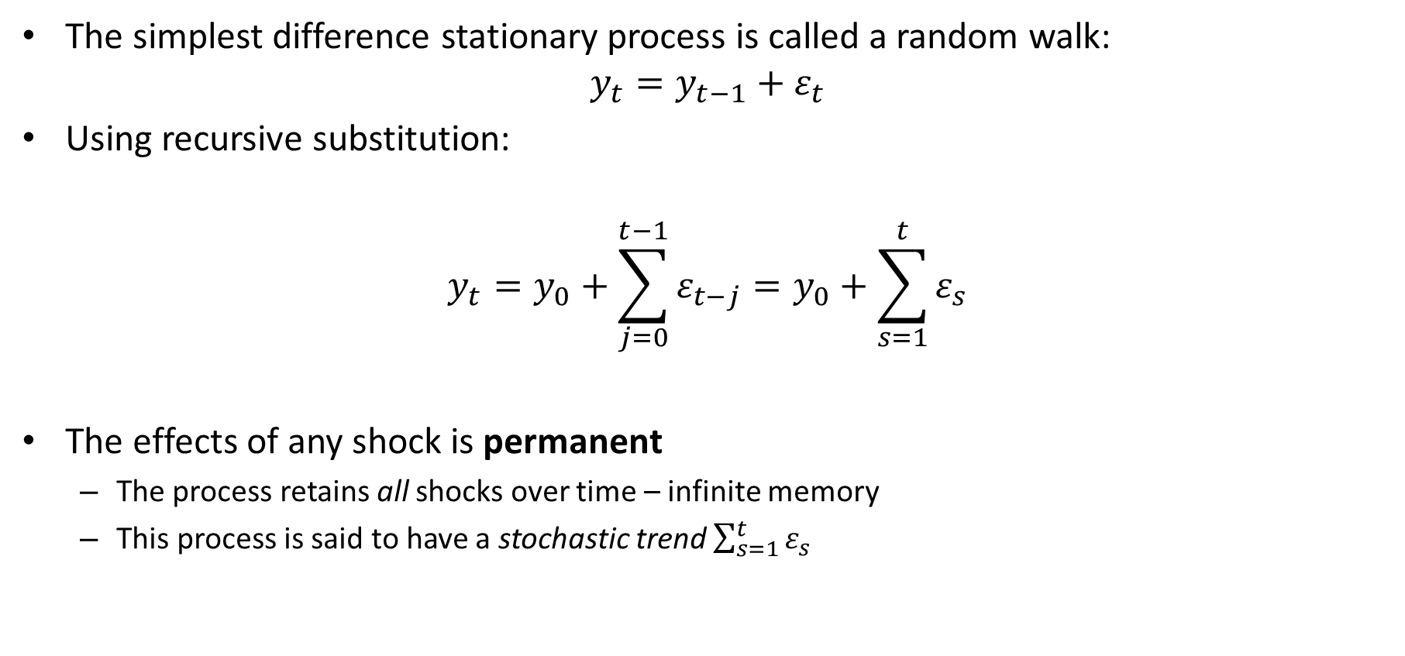
Difference Stationary Processes
The simplest difference stationary process is called a random walk:
$$y_{t}=y_{t−1}+ε_{t}$$
Using recursive substitution:
$$y_{t}=y_{0}+\sum_{j=0}^{t−1}{ε_{t−j}}=y_{0}+\sum_{s=1}^{t}{ε_{s}}$$
The effects of any shock is permanent
The process retains all shocks over time – infinite memory
This process is said to have a stochastic trend $\sum_{s=1}^{t}{ε_{s}}$

Slide 21
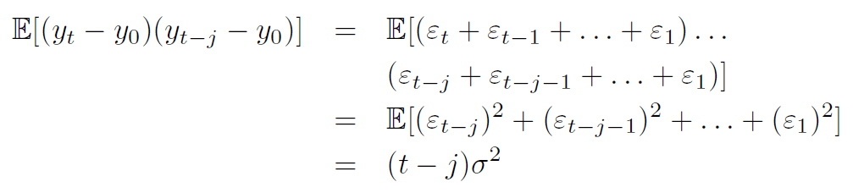

Difference Stationary Processes
Taking as $y_{0}$ as given, then
$$var\left(y_{t}|y_{0}\right)=E\left[{\left(ε_{t}+ε_{t−1}+…+ε_{1}\right)}^{2}\right]=tσ^{2}$$
So, the process is not covariance stationary, as the second moments depends on time

Slide 22
Difference Stationary Processes
This type of process is labelled difference stationary as the first difference is a stationary process:
Another term for these processes are integrated processes
is I(1) or first order integrated
is I(0) or not integrated
A process can also be integrated of a higher order
An I(d) process is one that is stationary in d^{th} difference

Slide 23
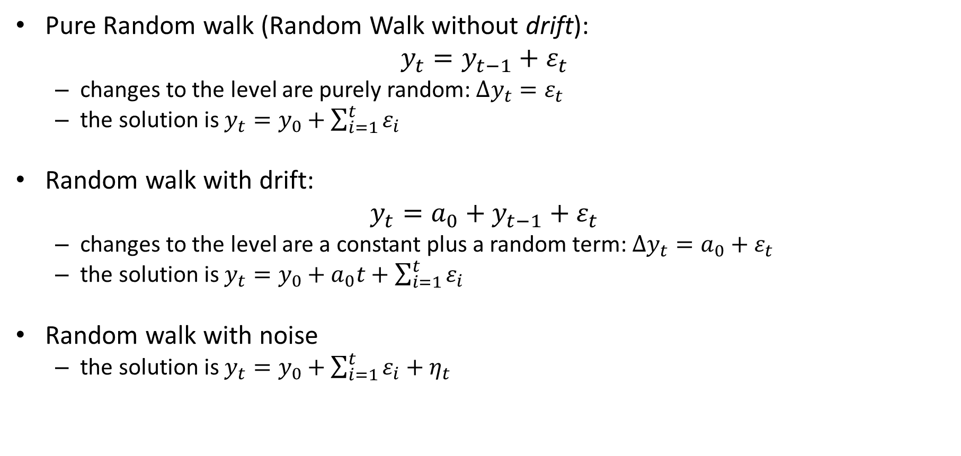
Classes of Difference Stationary Processes
Pure Random walk (Random Walk without drift):
$$y_{t}=y_{t−1}+ε_{t}$$
changes to the level are purely random: $Δy_{t}=ε_{t}$
the solution is $y_{t}=y_{0}+\sum_{i=1}^{t}{ε_{i}}$
Random walk with drift:
$$y_{t}=a_{0}+y_{t−1}+ε_{t}$$
changes to the level are a constant plus a random term: $Δy_{t}=a_{0}+ε_{t}$
the solution is $y_{t}=y_{0}+a_{0}t+\sum_{i=1}^{t}{ε_{i}}$
Random walk with noise
the solution is $y_{t}=y_{0}+\sum_{i=1}^{t}{ε_{i}}+η_{t}$

Slide 24
Economics
From economic theory, what predicts
A deterministic trend?
Linear?
Higher order?
A stochastic trend?

Slide 25
Differencing vs Detrending
We’ve shown that differencing a trend-stationary process (with a linear trend) yields a stationary process, although this is not the correct approach
What happens if we detrend a difference stationary process?

Slide 26
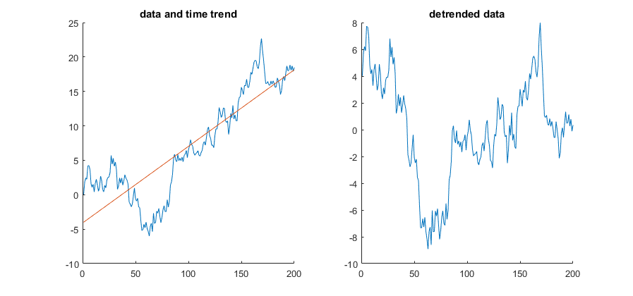
Detrending a pure random walk: linear trend

Slide 27
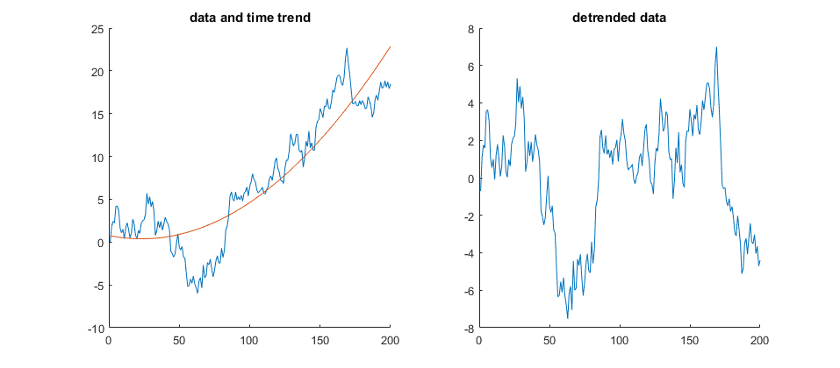
Detrending a pure random walk: quadratic trend

Slide 28
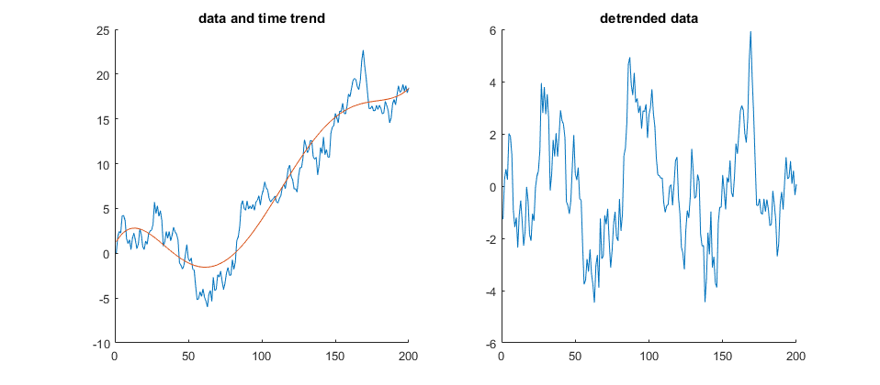
Detrending a pure random walk: 5th order trend

Slide 29
Differencing vs Detrending
What happens if we detrend a difference stationary process?
Typically, it will not remove the unit root
However, removing a polynomial in time of high enough order will yield a series that will test as if it is stationary, for any empirical test
This will change the properties of the data into something we manufactured
This is particularly problematic in studies of the business cycle: if the true cause of cyclicality is a stochastic trend, detrending (or deterministic filtering) may induce “spurious cycles”

Slide 30
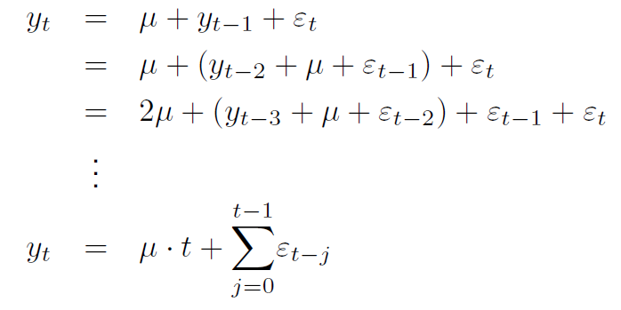
Random Walk with drift
An integrated process with a constant term is a random walk with drift:
Using recursive substitution:

Slide 31
Random Walk with drift
An integrated process with a constant term is a random walk with drift:
Using recursive substitution:
I.e. this process has both a deterministic and a stochastic trend
Deviations from the trend, however, are not stationary

Slide 32
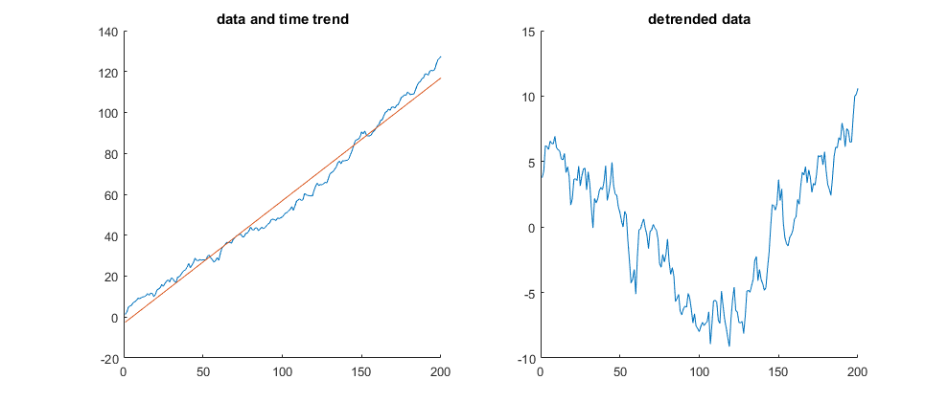
Detrending a random walk with drift

Slide 33
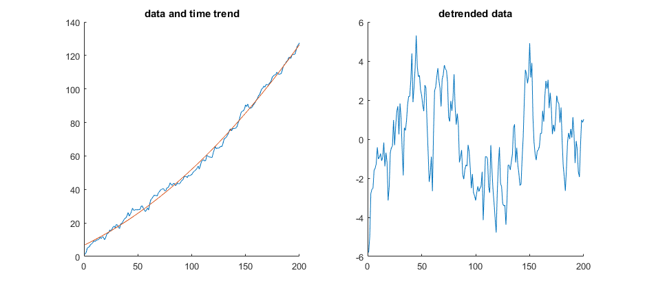
Detrending a random walk with drift

Slide 34
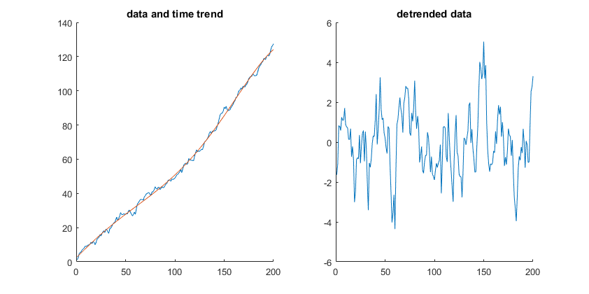
Detrending a random walk with drift

Slide 35
Detrending a random walk with drift
Linearly detrending a random walk with drift is unlikely to yield an empirically stationary process
Although, depending on the exact realization of shocks, it might
A high enough order polynomial in time will necessarily yield an empirically stationary series
Various approximation theorems show that a function (process) can be arbitrarily well approximated by a high enough polynomial in the basis function
Given this, “polynomials in time” in econometrics is at best treated for completeness.
I have rarely seen it used in an empirical study of a real structural economic problem
At least not one I would cite…

Slide 36
ACF of a random walk (conditional on an initial condition)
Standard deviation:
Autocorrelation:

Slide 37
ACF of a random walk
The empirical ACF of a process with a unit root will decay, but slowly
So will the ACF of a process with a deterministic trend
So will the ACF of an AR(p) process with roots close to one
Thus, we cannot use an ACF to distinguish between these cases

Slide 38
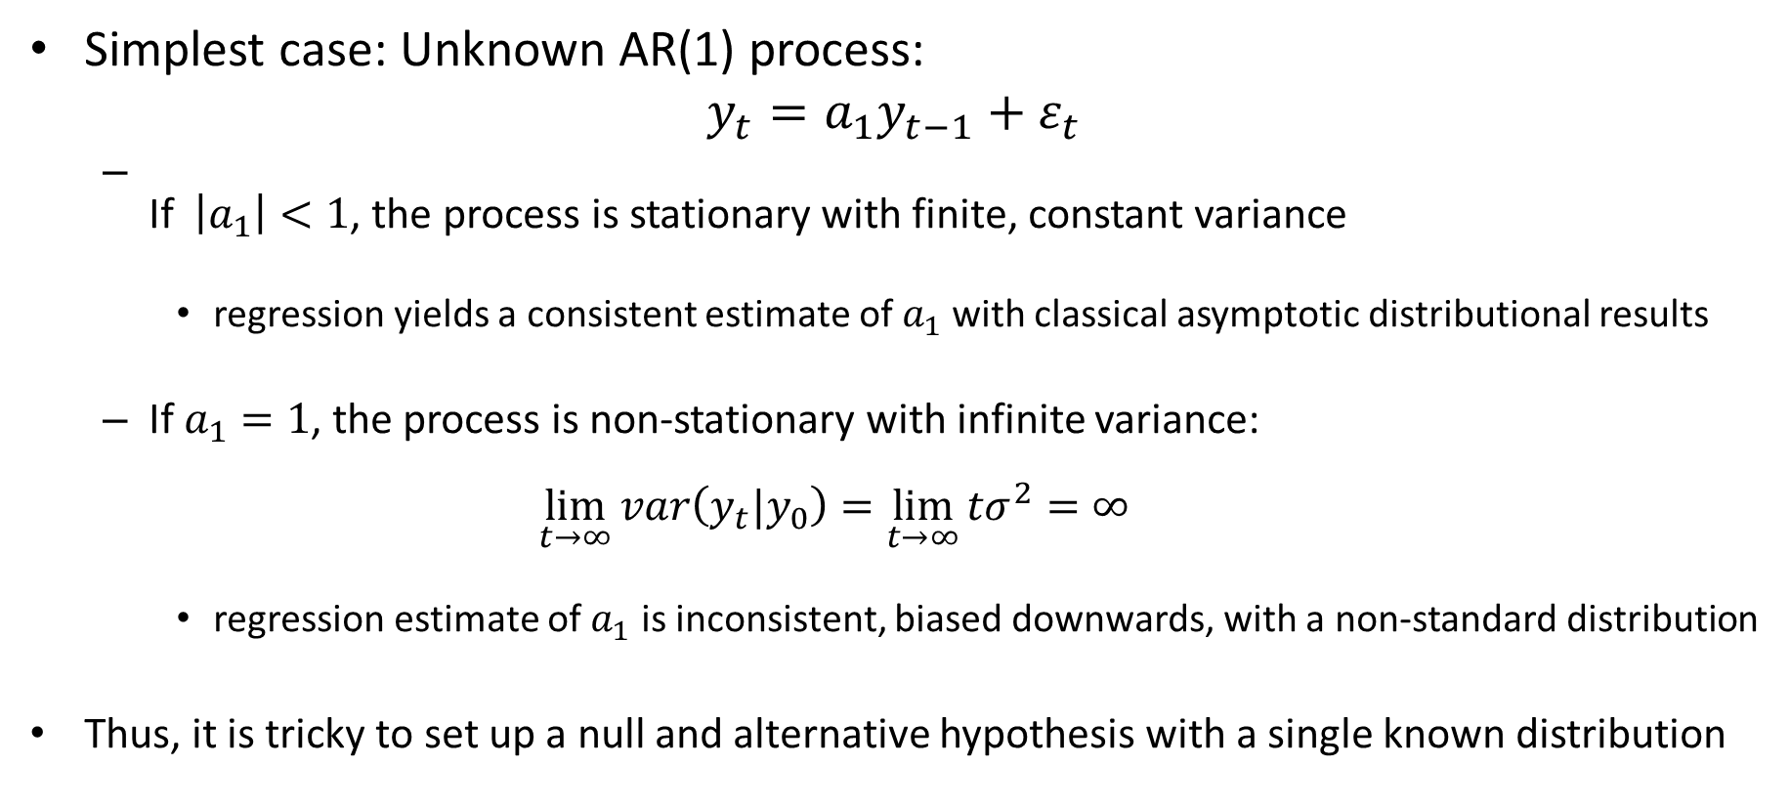
Detecting non-stationarity
Simplest case: Unknown AR(1) process:
$$y_{t}=a_{1}y_{t−1}+ε_{t}$$
If $\left|a_{1}\right|<1$, the process is stationary with finite, constant variance
regression yields a consistent estimate of $a_{1}$with classical asymptotic distributional results
If $a_{1}=1$, the process is non-stationary with infinite variance: $\lim_{t→∞}{var\left(y_{t}|y_{0}\right)}=\lim_{t→∞}{{tσ}^{2}}=∞$
regression estimate of $a_{1}$ is inconsistent, biased downwards, with a non-standard distribution
Thus, it is tricky to set up a null and alternative hypothesis with a single known distribution

Slide 39
Tests for non-stationarity
A variety of tests have been developed:
Dickey and Fuller (1979, 1981)
Phillips and Perron (1988)
ADF-GLS (Elliot, Rothemberg and Stock, 1996)
Ng and Perron (1995, 2001)
Kwiatkowski, Phillips, Schmidt and Shin (1992)
The first four are all extensions/variants of the DF test
They test the null of unit root against the alternative of no unit root
The last tests the null of no unit root against the alternative of a unit root
Note: Tests are only as good as the data is representative
If there are structural breaks, then a test that does not include this option will give inaccurate results
We will consider extensions to these tests that allow for one or more structural break under the non-linear topic

Slide 40
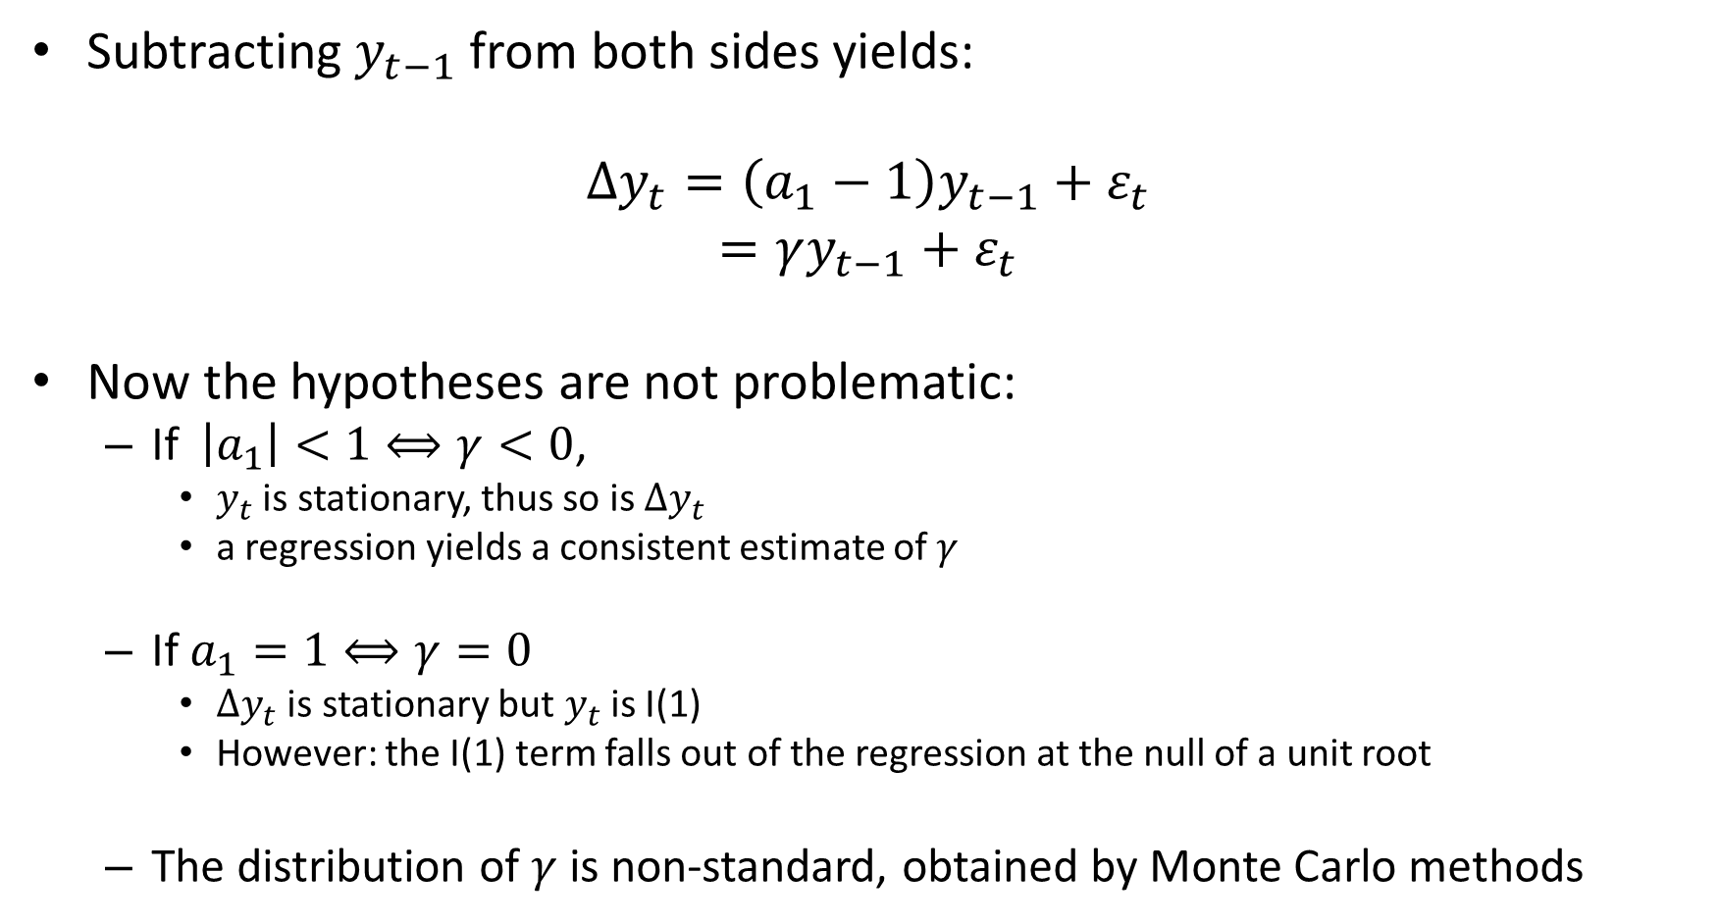
Dickey Fuller test
Subtracting $y_{t−1}$ from both sides yields:
$$∆y_{t}=\left(a_{1}−1\right)y_{t−1}+ε_{t}$$
$$=γy_{t−1}+ε_{t}$$
Now the hypotheses are not problematic:
If $\left|a_{1}\right|<1⟺γ<0$,
$y_{t}$ is stationary, thus so is $∆y_{t}$
a regression yields a consistent estimate of $γ$
If $a_{1}=1⟺γ=0$
$∆y_{t}$ is stationary but $y_{t}$ is I(1)
However: the I(1) term falls out of the regression at the null of a unit root
The distribution of $γ$ is non-standard, obtained by Monte Carlo methods

Slide 41
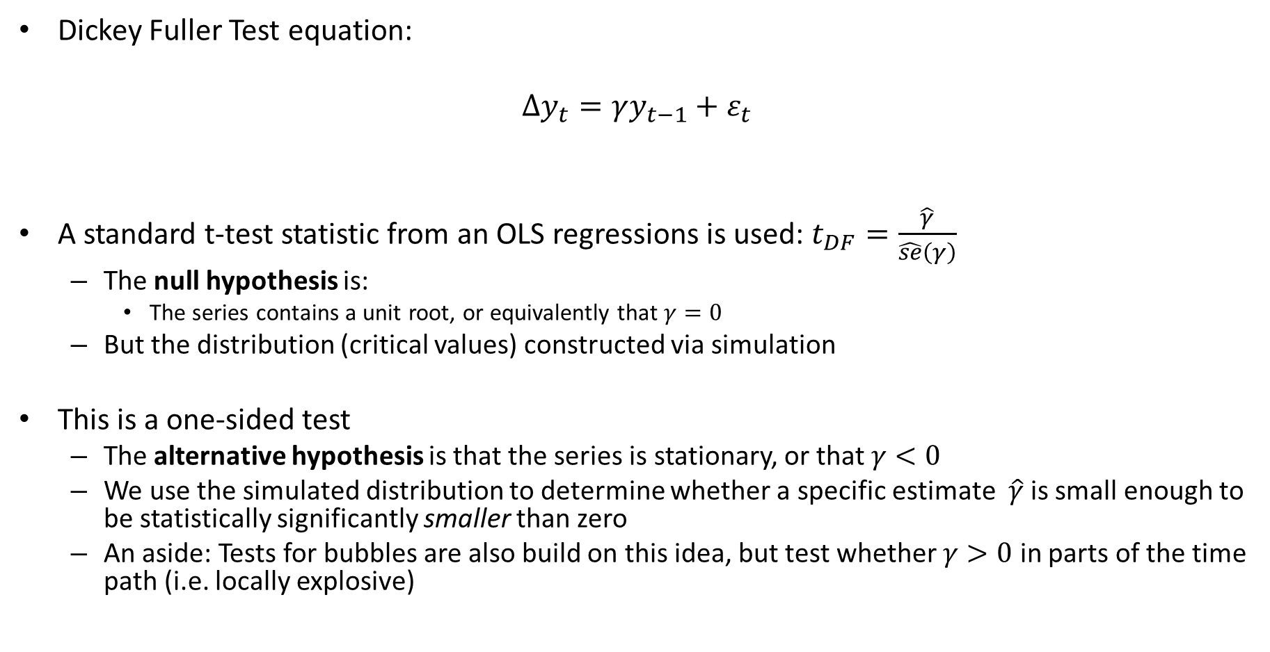
Dickey Fuller test
Dickey Fuller Test equation:
$$∆y_{t}=γy_{t−1}+ε_{t}$$
A standard t-test statistic from an OLS regressions is used: $t_{DF}=\frac{\hat{γ}}{\hat{se}\left(γ\right)}$
The null hypothesis is:
The series contains a unit root, or equivalently that $γ=0$
But the distribution (critical values) constructed via simulation
This is a one-sided test
The alternative hypothesis is that the series is stationary, or that $γ<0$
We use the simulated distribution to determine whether a specific estimate $\hat{γ}$ is small enough to be statistically significantly smaller than zero
An aside: Tests for bubbles are also build on this idea, but test whether $γ>0$ in parts of the time path (i.e. locally explosive)

Slide 42
Dickey Fuller test
How comfortable are you with the concepts of a null and alternative hypothesis?
If not, review and come talk to me
Dickey Fuller Test equation:
$$∆y_{t}=γy_{t−1}+ε_{t}$$
A standard t-test statistic from an OLS regressions is used: $t_{DF}=\frac{\hat{γ}}{\hat{se}\left(γ\right)}$
The null hypothesis is:
The series contains a unit root, or equivalently that $γ=0$
But the distribution (critical values) constructed via simulation
This is a one-sided test
The alternative hypothesis is that the series is stationary, or that $γ<0$
We use the simulated distribution to determine whether a specific estimate $\hat{γ}$ is small enough to be statistically significantly smaller than zero
An aside: Tests for bubbles are also build on this idea, but test whether $γ>0$ in parts of the time path (i.e. locally explosive)

Slide 43
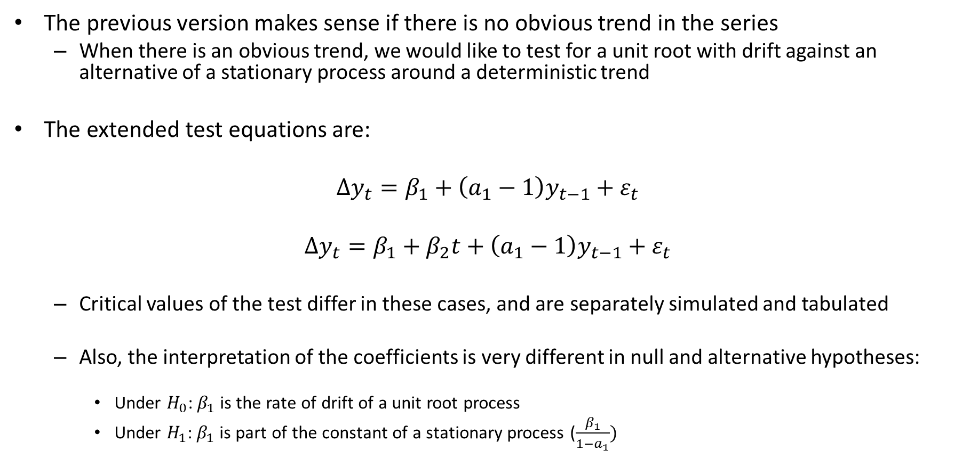
Dickey Fuller Test
The previous version makes sense if there is no obvious trend in the series
When there is an obvious trend, we would like to test for a unit root with drift against an alternative of a stationary process around a deterministic trend
The extended test equations are:
$$∆y_{t}=β_{1}+\left(a_{1}−1\right)y_{t−1}+ε_{t}$$
$$∆y_{t}=β_{1}+β_{2}t+\left(a_{1}−1\right)y_{t−1}+ε_{t}$$
Critical values of the test differ in these cases, and are separately simulated and tabulated
Also, the interpretation of the coefficients is very different in null and alternative hypotheses:
Under $H_{0}$: $β_{1}$ is the rate of drift of a unit root process
Under $H_{1}$: $β_{1}$ is part of the constant of a stationary process ($\frac{β_{1}}{1−a_{1}})$

Slide 44
Augmented Dickey Fuller Tests
The above assumed we knew it was an ARIMA(1,1,0) or ARIMA(1,0,0) process, not some other ARIMA(p,d,q) process
I.e. it does not allow for higher order AR parts, or any MA parts
For the Dickey Fuller tests to be valid, the estimators of the coefficients must be consistent
I.e. the test regression has to encompass the DGP, for which a minimum requirement is white noise residuals
No autocorrelation (no ARMA behaviour)
Constant variance
If the stationary part of the process is a higher order ARMA(p,q) process, the DF test equation above will not yield consistent estimates
because it will leave systematic information in the residuals
The ADF test deals with the autocorrelation concern, but not the constant variance concern

Slide 45
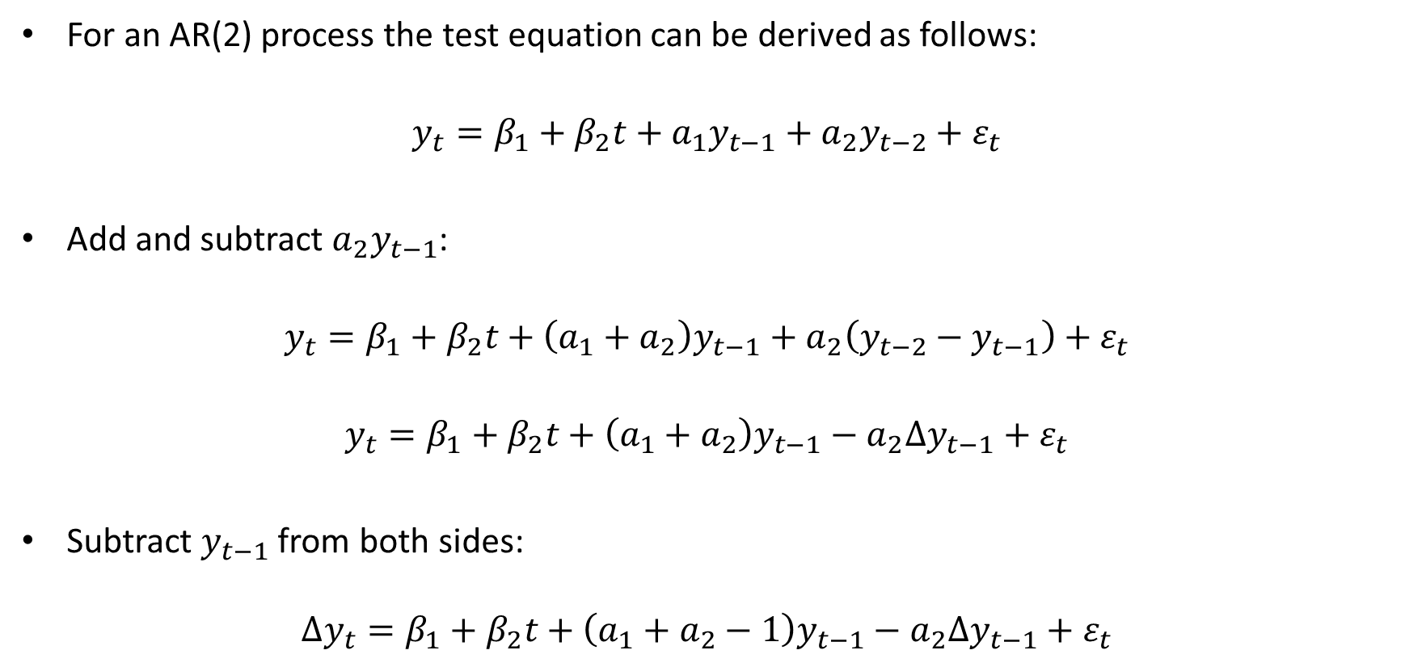
Augmented Dickey Fuller Tests
For an AR(2) process the test equation can be derived as follows:
$$y_{t}=β_{1}+β_{2}t+a_{1}y_{t−1}+a_{2}y_{t−2}+ε_{t}$$
Add and subtract $a_{2}y_{t−1}$:
$$y_{t}=β_{1}+β_{2}t+\left(a_{1}+a_{2}\right)y_{t−1}+a_{2}\left(y_{t−2}−y_{t−1}\right)+ε_{t}$$
$$y_{t}=β_{1}+β_{2}t+\left(a_{1}+a_{2}\right)y_{t−1}−a_{2}∆y_{t−1}+ε_{t}$$
Subtract $y_{t−1}$ from both sides:
$$∆y_{t}=β_{1}+β_{2}t+\left(a_{1}+a_{2}−1\right)y_{t−1}−a_{2}∆y_{t−1}+ε_{t}$$

Slide 46
Augmented Dickey Fuller Tests
For more complicated ARIMA processes?
i.e. with MA parts
ARIMA(p,1,0) can approximate ARIMA(p’,1,q) well

Slide 47
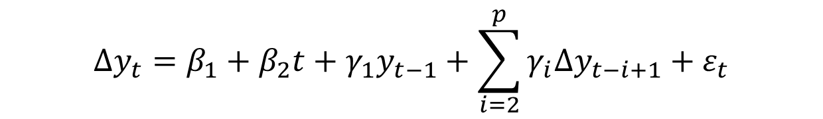
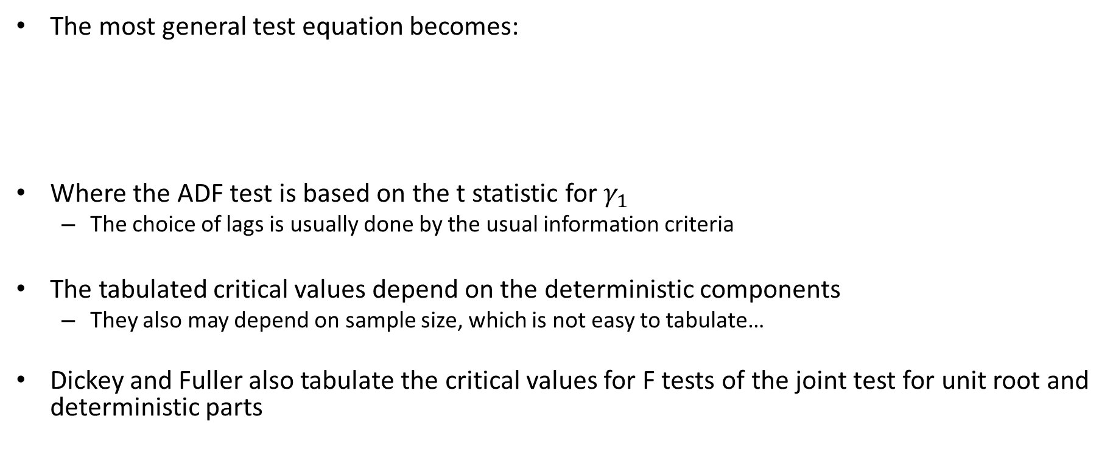
Augmented Dickey Fuller Tests
The most general test equation becomes:
Where the ADF test is based on the t statistic for $γ_{1}$
The choice of lags is usually done by the usual information criteria
The tabulated critical values depend on the deterministic components
They also may depend on sample size, which is not easy to tabulate…
Dickey and Fuller also tabulate the critical values for F tests of the joint test for unit root and deterministic parts
$$∆y_{t}=β_{1}+β_{2}t+γ_{1}y_{t−1}+\sum_{i=2}^{p}{γ_{i}∆y_{t−i+1}}+ε_{t}$$

Slide 48
ADF tests: how to choose the appropriate version
In previous years, I followed the textbook and how it often applied in papers
Test all versions, argue for the best
Kevin Kotze argues for a general to specific approach, but Enders warns against this as
Last year, I realized that this was problematic as many of the tests have nonsensical alternative hypotheses
In my opinion, there are only two versions of the test that are well motivated, and it depends entirely on the time series patterns of the data:
Specifically, does the process have an obvious trend or not
We will explore this carefully in the tutorial session
It is critical that you go through the basic ideas of the test very carefully before that session

Slide 49
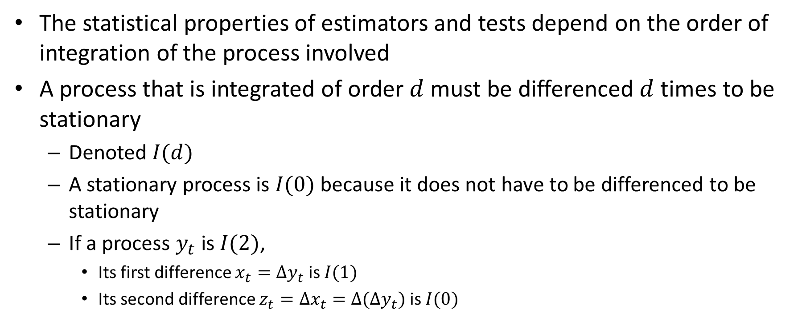
ADF tests: how to determine the order of integration
The statistical properties of estimators and tests depend on the order of integration of the process involved
A process that is integrated of order $d$ must be differenced $d$ times to be stationary
Denoted $I(d)$
A stationary process is $I(0)$ because it does not have to be differenced to be stationary
If a process $y_{t}$ is $I(2)$,
Its first difference $x_{t}=Δy_{t}$ is $I(1)$
Its second difference $z_{t}=Δx_{t}=Δ(Δy_{t})$ is $I(0)$

Slide 50
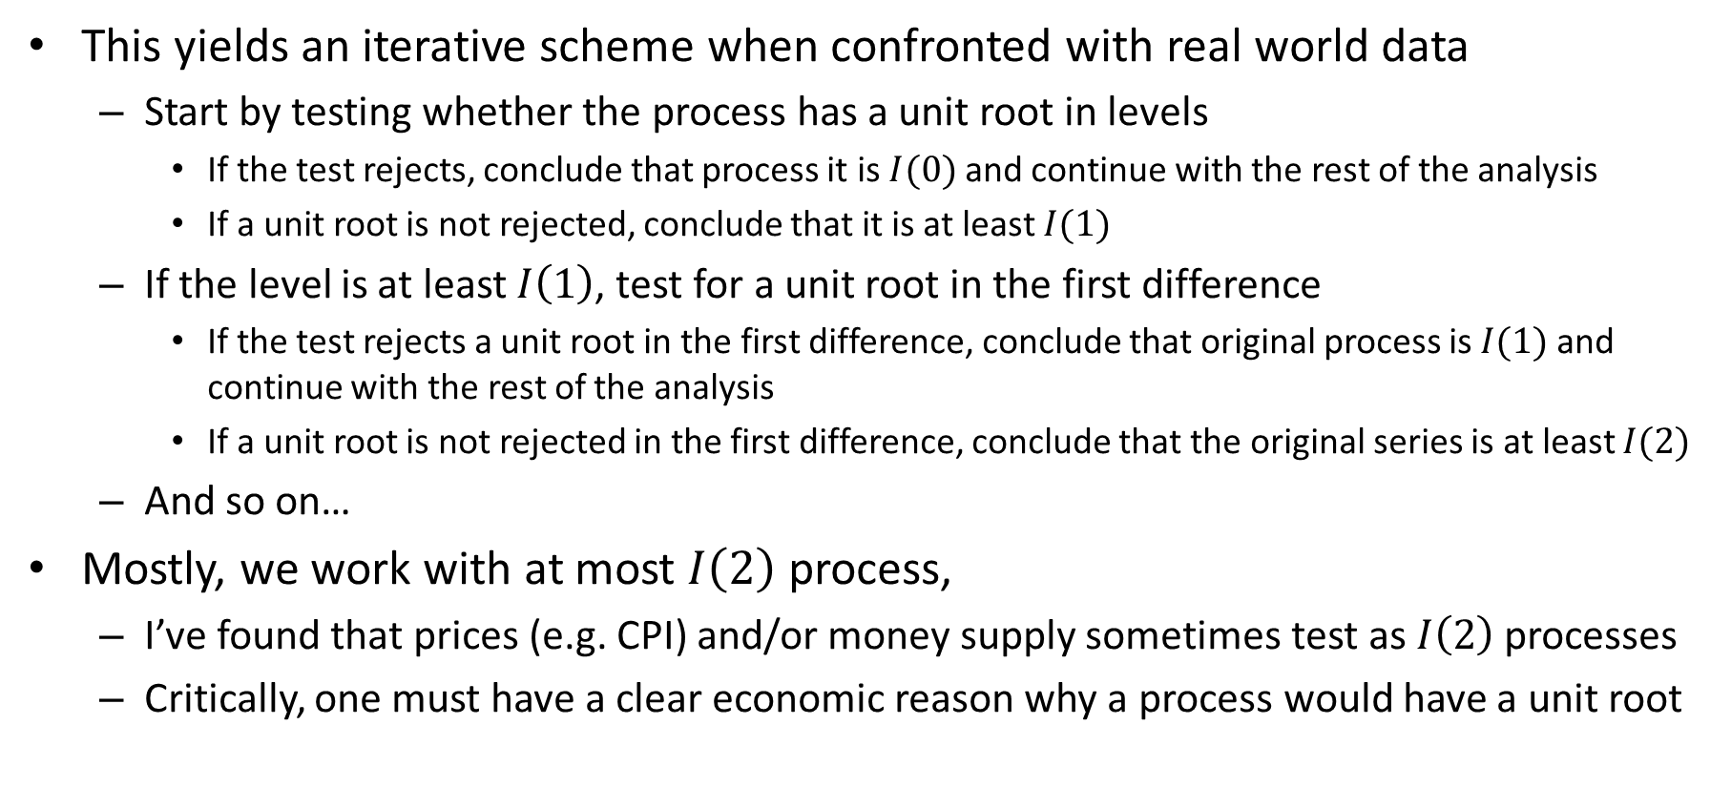
ADF tests: how to determine the order of integration
This yields an iterative scheme when confronted with real world data
Start by testing whether the process has a unit root in levels
If the test rejects, conclude that process it is $I(0)$ and continue with the rest of the analysis
If a unit root is not rejected, conclude that it is at least $I(1)$
If the level is at least $I\left(1\right)$, test for a unit root in the first difference
If the test rejects a unit root in the first difference, conclude that original process is $I(1)$ and continue with the rest of the analysis
If a unit root is not rejected in the first difference, conclude that the original series is at least $I(2)$
And so on…
Mostly, we work with at most $I\left(2\right)$ process,
I’ve found that prices (e.g. CPI) and/or money supply sometimes test as $I\left(2\right)$ processes
Critically, one must have a clear economic reason why a process would have a unit root

Slide 51
A General to Specific testing approach
Source: Kevin Kotze
Economodel.com

Slide 52
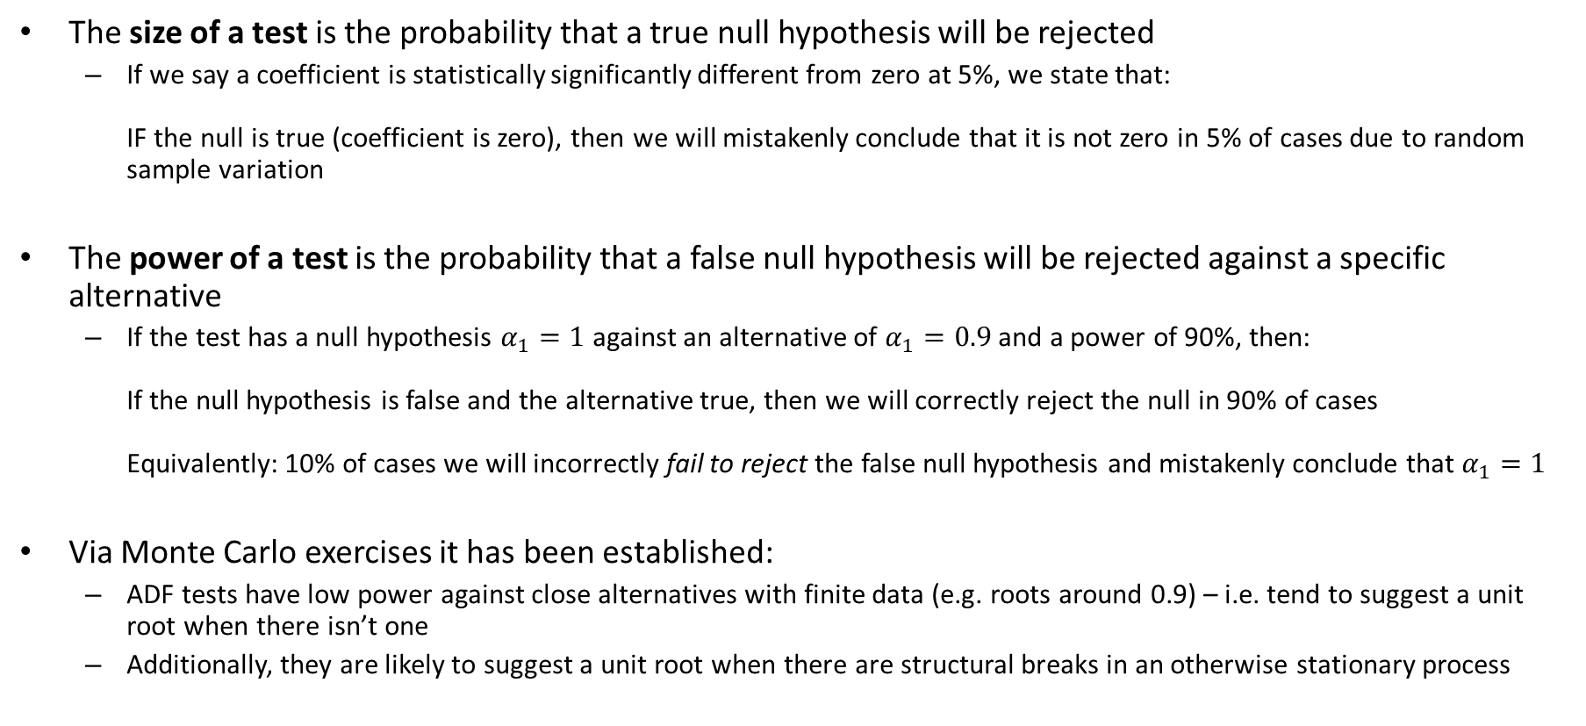
Size vs Power of a statistical test (jargon to know)
The size of a test is the probability that a true null hypothesis will be rejected
If we say a coefficient is statistically significantly different from zero at 5%, we state that: IF the null is true (coefficient is zero), then we will mistakenly conclude that it is not zero in 5% of cases due to random sample variation
The power of a test is the probability that a false null hypothesis will be rejected against a specific alternative
If the test has a null hypothesis $α_{1}=1$ against an alternative of $α_{1}=0.9$ and a power of 90%, then: If the null hypothesis is false and the alternative true, then we will correctly reject the null in 90% of cases Equivalently: 10% of cases we will incorrectly fail to reject the false null hypothesis and mistakenly conclude that $α_{1}=1$
Via Monte Carlo exercises it has been established:
ADF tests have low power against close alternatives with finite data (e.g. roots around 0.9) – i.e. tend to suggest a unit root when there isn’t one
Additionally, they are likely to suggest a unit root when there are structural breaks in an otherwise stationary process

Slide 53
Other tests:
Phillips and Perron (1988)
Derive asymptotic distributions of the basic AR(1) test equation statistic under very general assumptions on the residuals
Allowing for both autocorrelation and heteroscedasticity (non constant variance)
I.e. the residuals may have autocorrelated levels and variances (GARCH behaviour)
This is analytically very dense and relies on functional analysis (i.e. the asymptotic convergence of functions)
They construct adjusted DF test statistics (i.e. only up to AR(1) + deterministic parts) that are asymptotically consistent
Similar to “small sample corrections” elsewhere in econometrics
Simulations show that can improve on ADF power (see simulations for T=100, AR coeff 0.85)

Slide 54
A pause for context
Up to this point is what I expect you to focus on in technical detail
The purpose is to
Understand what an integrated process is, and
Have a systematic way to test for the order of integration of an observed time series
The ADF is the simplest and most common application
It has shortcomings that later work have improved on
What comes after is to expose you to the extensions that have since been designed
I expect you to know the gist of the issues, not any mathematical detail
For professional econometric work, you will have to delve a little bit into each of the following to know when and why to use the different tests

Slide 55
Other tests:
Phillips and Perron (1988):
Constructed the exact, theoretical asymptotic distribution of the levels equation under weak assumptions
Does not perform as well in small samples (tentative: see Enders)
Requires deep measure theory to follow:

Slide 56
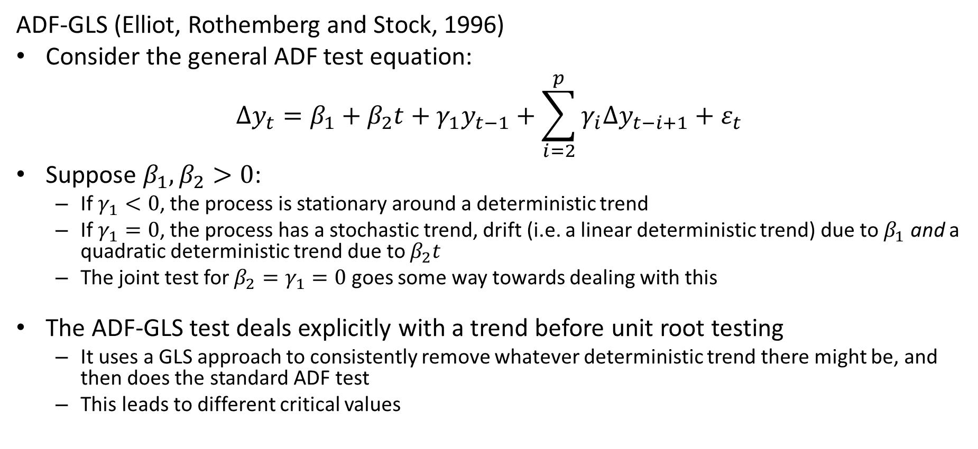
Other tests:
ADF-GLS (Elliot, Rothemberg and Stock, 1996)
Consider the general ADF test equation:
$$∆y_{t}=β_{1}+β_{2}t+γ_{1}y_{t−1}+\sum_{i=2}^{p}{γ_{i}∆y_{t−i+1}}+ε_{t}$$
Suppose $β_{1},β_{2}>0$:
If $γ_{1}<0$, the process is stationary around a deterministic trend
If $γ_{1}=0$, the process has a stochastic trend, drift (i.e. a linear deterministic trend) due to $β_{1}$ and a quadratic deterministic trend due to $β_{2}t$
The joint test for $β_{2}=γ_{1}=0$ goes some way towards dealing with this
The ADF-GLS test deals explicitly with a trend before unit root testing
It uses a GLS approach to consistently remove whatever deterministic trend there might be, and then does the standard ADF test
This leads to different critical values

Slide 57
Other tests:
Ng and Perron (1995, 2001)
Combines the ideas of Phillips and Perron (1988) and the ADF-GLS approach of Elliot, Rothemberg and Stock (1996)
Take the ADF-GLS approach to detrend before testing
Then derive the asymptotic distribution of test statistics as in Phillips and Perron
This yields new small sample adjusted test statistics that are asymptotically consistent under very general error processes
Not yet available in many packages

Slide 58
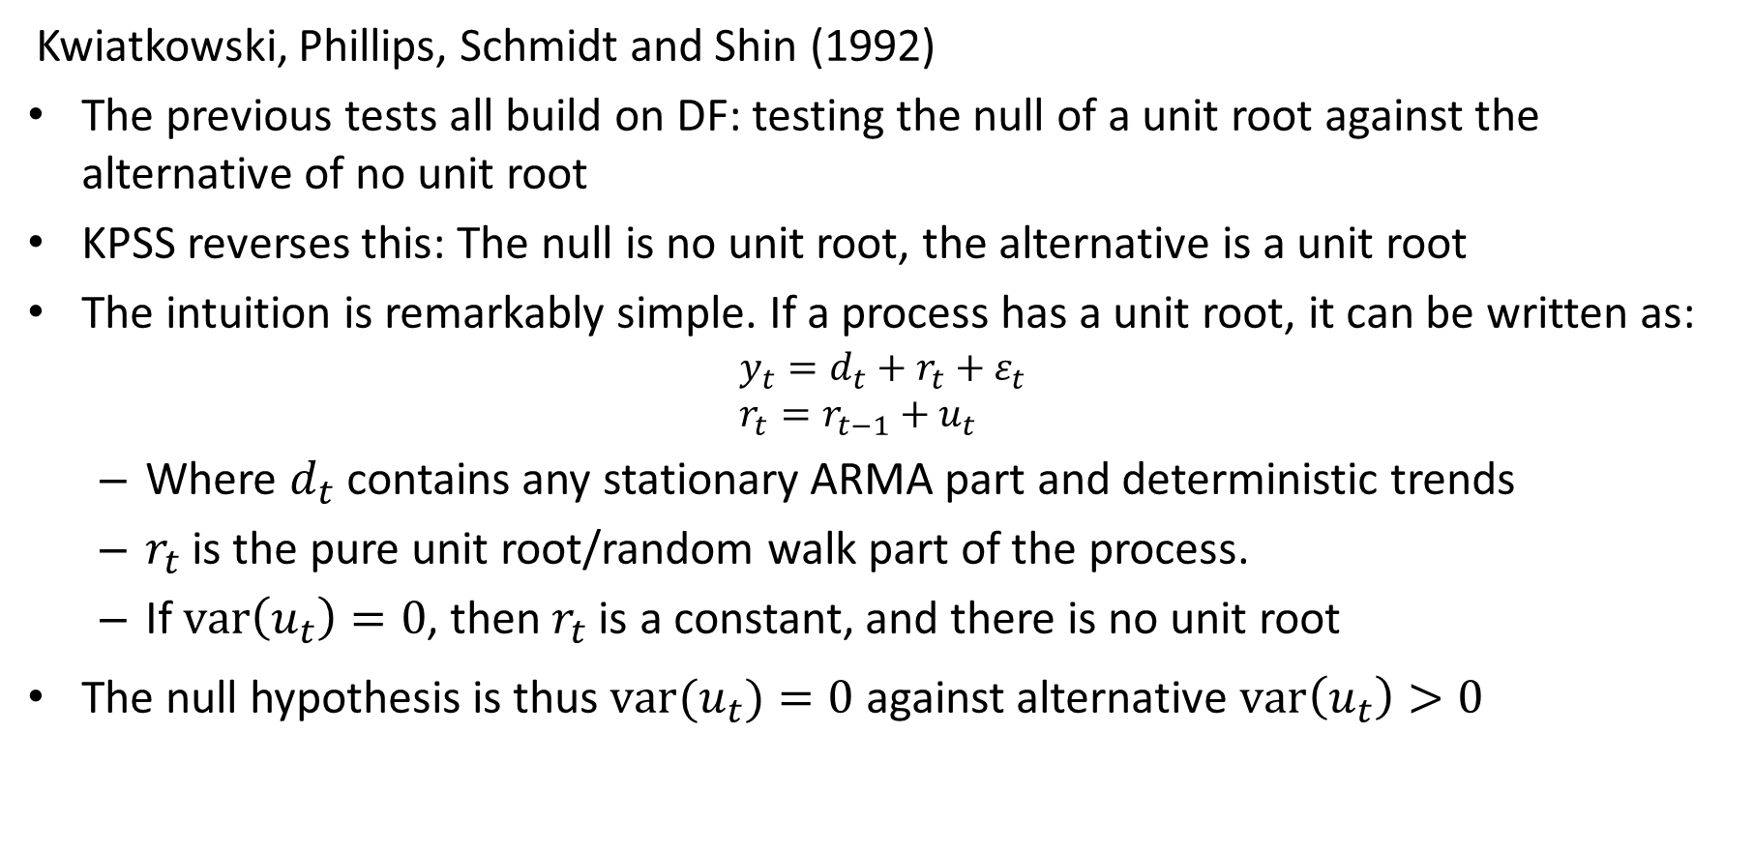
Other tests:
Kwiatkowski, Phillips, Schmidt and Shin (1992)
The previous tests all build on DF: testing the null of a unit root against the alternative of no unit root
KPSS reverses this: The null is no unit root, the alternative is a unit root
The intuition is remarkably simple. If a process has a unit root, it can be written as:
$$y_{t}=d_{t}+r_{t}+ε_{t} \\ r_{t}=r_{t−1}+u_{t}$$
Where $d_{t}$ contains any stationary ARMA part and deterministic trends
$r_{t}$ is the pure unit root/random walk part of the process.
If $var\left(u_{t}\right)=0$, then $r_{t}$ is a constant, and there is no unit root
The null hypothesis is thus $var(u_{t})=0$ against alternative $var\left(u_{t}\right)>0$

Slide 59
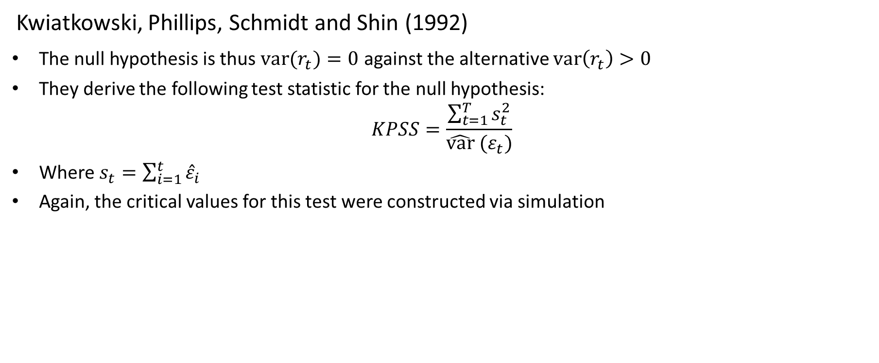
Other tests:
Kwiatkowski, Phillips, Schmidt and Shin (1992)
The null hypothesis is thus $var(r_{t})=0$ against the alternative $var\left(r_{t}\right)>0$
They derive the following test statistic for the null hypothesis:
$$KPSS=\frac{\sum_{t=1}^{T}{s_{t}^{2}}}{\hat{var} (ε_{t})}$$
Where $s_{t}=\sum_{i=1}^{t}{{\hat{ε}}_{i}}$
Again, the critical values for this test were constructed via simulation

Slide 60
Multivariate Danger: Spurious Regression
4 multivariate cases:
y and z are both stationary
normal regressions valid
y is I(b) and z is I(d) with b>d
Levels regression meaningless
y and z are I(1) with independent stochastic trends
Levels regression meaningless, in differences, valid
But often find significant coefficients = spurious regression results
y and z are I(1) with common stochastic trend
Levels regression valid and super consistent
Variables are “co-integrated”

Slide 61
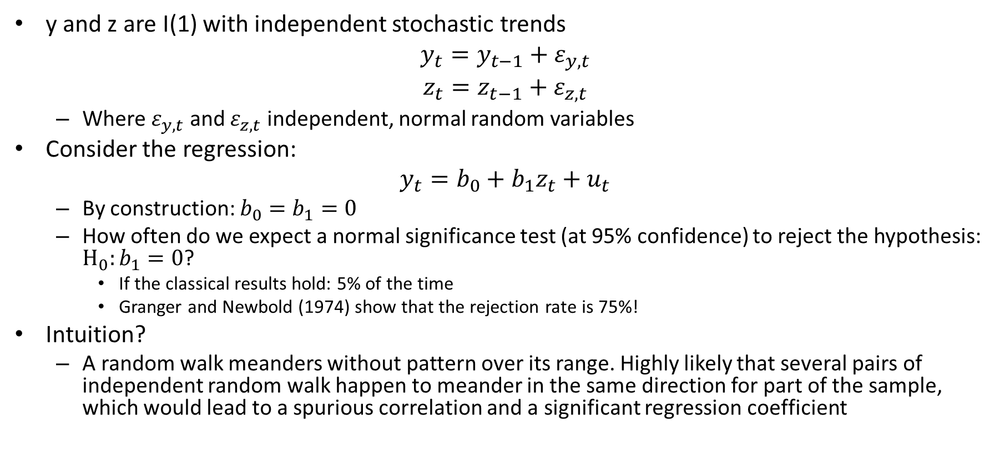
Multivariate Danger: Spurious Regression
y and z are I(1) with independent stochastic trends
$$y_{t}=y_{t−1}+ε_{y,t}$$
$$z_{t}=z_{t−1}+ε_{z,t}$$
Where $ε_{y,t}$ and $ε_{z,t}$ independent, normal random variables
Consider the regression:
$$y_{t}=b_{0}+b_{1}z_{t}+u_{t}$$
By construction: $b_{0}=b_{1}=0$
How often do we expect a normal significance test (at 95% confidence) to reject the hypothesis: $H_{0}:b_{1}=0$?
If the classical results hold: 5% of the time
Granger and Newbold (1974) show that the rejection rate is 75%!
Intuition?
A random walk meanders without pattern over its range. Highly likely that several pairs of independent random walk happen to meander in the same direction for part of the sample, which would lead to a spurious correlation and a significant regression coefficient

Slide 62
My (non-text-book) summary
Pure deterministic trends make no sense in any economic model that I have ever seen
At best it can be a “local”/small sample solution
I am truly sceptical of any such “fixes”
However, I’m in a very small minority in the larger literature…
A stochastic trend in any series does not always make economic “common sense”
Use your economic understanding to judge all cases
Detrending OR differencing
At best a crude way to summarize data in a specific sample
Almost certainly strips out informative (long run) correlations with other variables that are more interesting to an economist
There are situations in which you can extract “real” economic conclusions from “pre-differencing” but they should be motivated on economic grounds, not empirical grounds.
Always use co-integration analysis when you encounter a set of variables that
Seem to be individually integrated (and tests as such)
Can theoretically consistently be considered to be integrated
Should be in a joint equilibrium relationship based on economic theory

Slide 63
Next week: Stationary Multivariate Models
Read chapter 5 of Enders
Brush up on Linear Algebra and Matrix operations

Slide 64
Econometrics 871 Time Series
Topic 4: Tutorial
Replicating the Dickey-Fuller distribution

Slide 65
Tutorial: Monte Carlo Experiment:
Create data according to DGP of interest
Do candidate estimation
Compare distribution of residuals to standard predicted distribution
Use simulated distribution to obtain “true” critical values

Slide 66
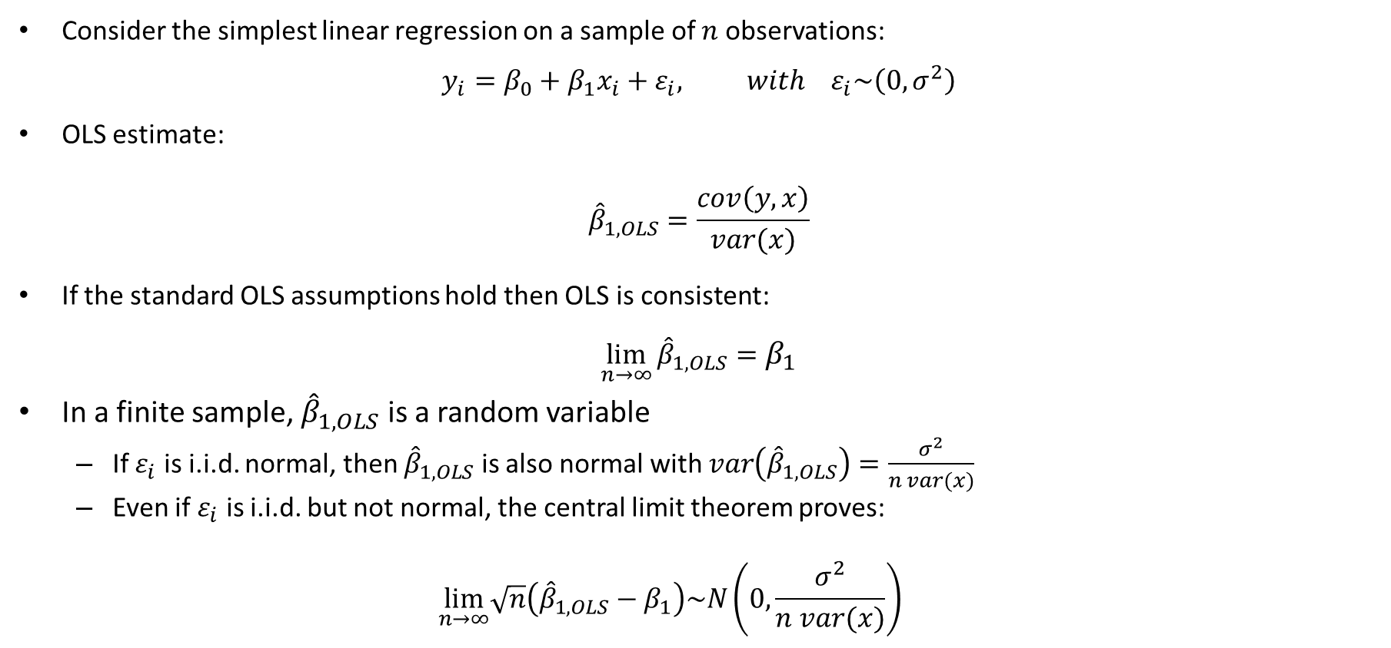
Review of asymptotic results and hypothesis testing
Consider the simplest linear regression on a sample of $n$ observations:
$$y_{i}=β_{0}+β_{1}x_{i}+ε_{i}, with ε_{i}\sim \left(0,σ^{2}\right)$$
OLS estimate:
$${\hat{β}}_{1,OLS}=\frac{cov\left(y,x\right)}{var(x)}$$
If the standard OLS assumptions hold then OLS is consistent:
$$\lim_{n→∞}{{\hat{β}}_{1,OLS}}=β_{1}$$
In a finite sample, ${\hat{β}}_{1,OLS}$ is a random variable
If $ε_{i}$ is i.i.d. normal, then ${\hat{β}}_{1,OLS}$ is also normal with $var\left({\hat{β}}_{1,OLS}\right)=\frac{σ^{2}}{n var(x)}$
Even if $ε_{i}$ is i.i.d. but not normal, the central limit theorem proves:
$$\lim_{n→∞}\sqrt{n}\left({\hat{β}}_{1,OLS}−β_{1}\right)\sim N\left(0,\frac{σ^{2}}{n var(x)}\right)$$

Slide 67
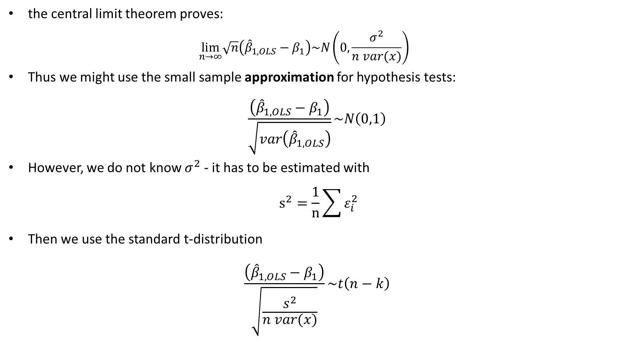
Review of asymptotic results and hypothesis testing
the central limit theorem proves:
$$\lim_{n→∞}\sqrt{n}\left({\hat{β}}_{1,OLS}−β_{1}\right)\sim N\left(0,\frac{σ^{2}}{n var(x)}\right)$$
Thus we might use the small sample approximation for hypothesis tests:
$$\frac{\left({\hat{β}}_{1,OLS}−β_{1}\right)}{\sqrt{var\left({\hat{β}}_{1,OLS}\right)}}\sim N\left(0,1\right)$$
However, we do not know $σ^{2}$ - it has to be estimated with
$$s^{2}=\frac{1}{n}\sum{ε_{i}^{2}}$$
Then we use the standard t-distribution
$$\frac{\left({\hat{β}}_{1,OLS}−β_{1}\right)}{\sqrt{\frac{s^{2}}{n var(x)}}}\sim t\left(n−k\right)$$

Slide 68
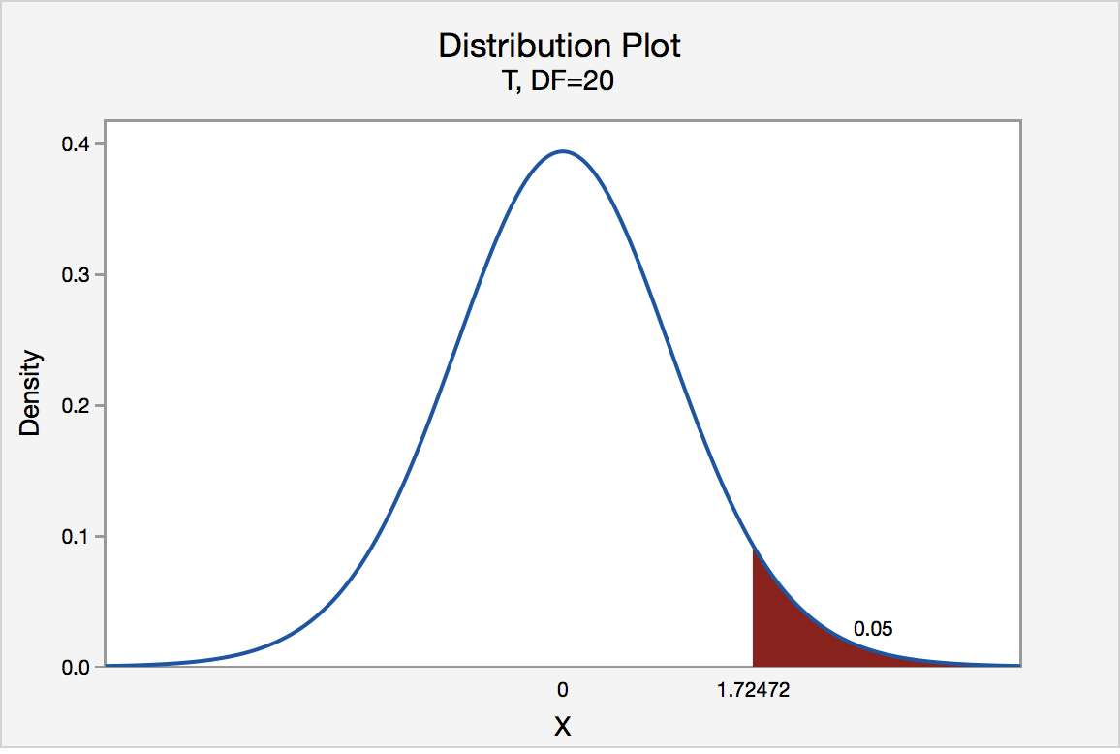

Slide 69
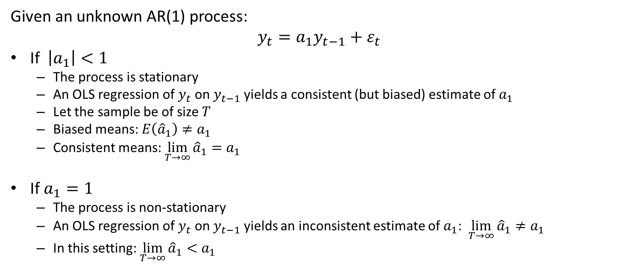
Fundamental Setting
Given an unknown AR(1) process:
$$y_{t}=a_{1}y_{t−1}+ε_{t}$$
If $\left|a_{1}\right|<1$
The process is stationary
An OLS regression of $y_{t}$ on $y_{t−1}$ yields a consistent (but biased) estimate of $a_{1}$
Let the sample be of size $T$
Biased means: $E\left({\hat{a}}_{1}\right)≠a_{1}$
Consistent means: $\lim_{T→∞}{{\hat{a}}_{1}}=a_{1}$
If $a_{1}=1$
The process is non-stationary
An OLS regression of $y_{t}$ on $y_{t−1}$ yields an inconsistent estimate of $a_{1}$: $\lim_{T→∞}{{\hat{a}}_{1}}≠a_{1}$
In this setting: $\lim_{T→∞}{{\hat{a}}_{1}}<a_{1}$

Slide 70
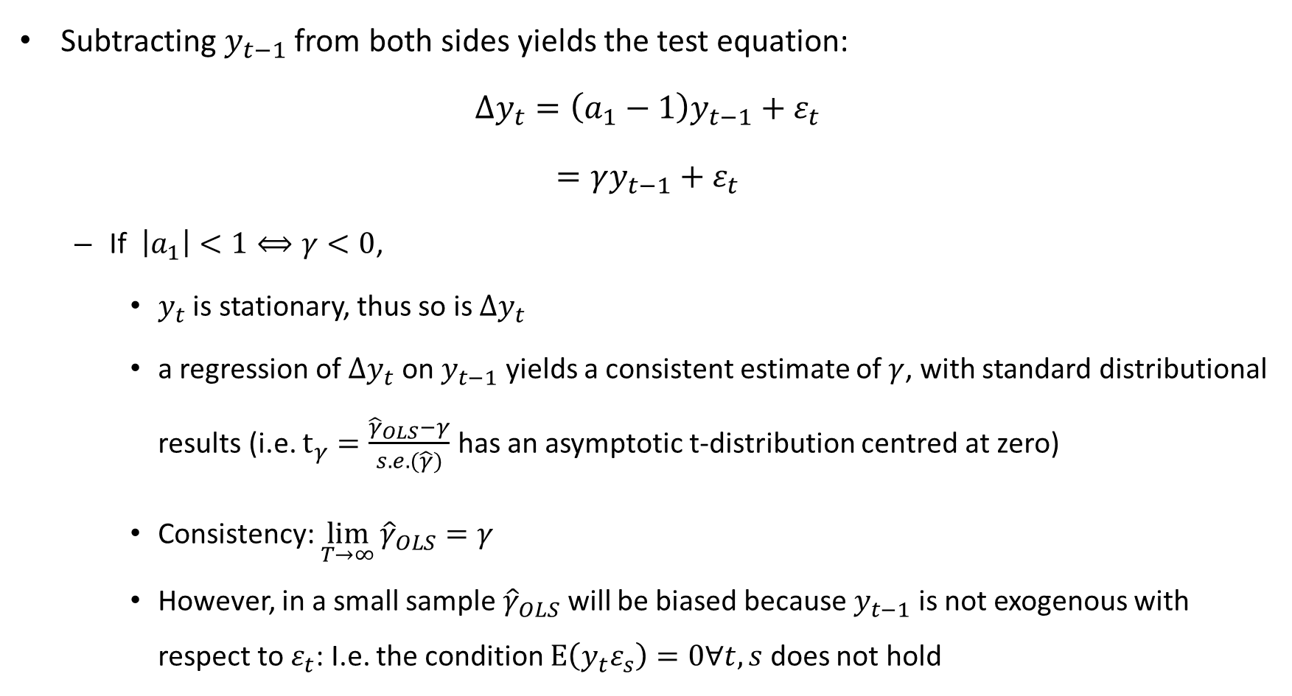
Test equation:
Subtracting $y_{t−1}$ from both sides yields the test equation:
$$∆y_{t}=\left(a_{1}−1\right)y_{t−1}+ε_{t}$$
$$=γy_{t−1}+ε_{t}$$
If $\left|a_{1}\right|<1⟺γ<0$,
$y_{t}$ is stationary, thus so is $∆y_{t}$
a regression of ${∆y}_{t}$ on $y_{t−1}$ yields a consistent estimate of $γ$, with standard distributional results (i.e. $t_{γ}=\frac{{\hat{γ}}_{OLS}−γ}{s.e.(\hat{γ})}$ has an asymptotic t-distribution centred at zero)
Consistency: $\lim_{T→∞}{{\hat{γ}}_{OLS}}=γ$
However, in a small sample ${\hat{γ}}_{OLS}$ will be biased because $y_{t−1}$ is not exogenous with respect to $ε_{t}$: I.e. the condition $E\left(y_{t}ε_{s}\right)=0∀t,s$ does not hold

Slide 71
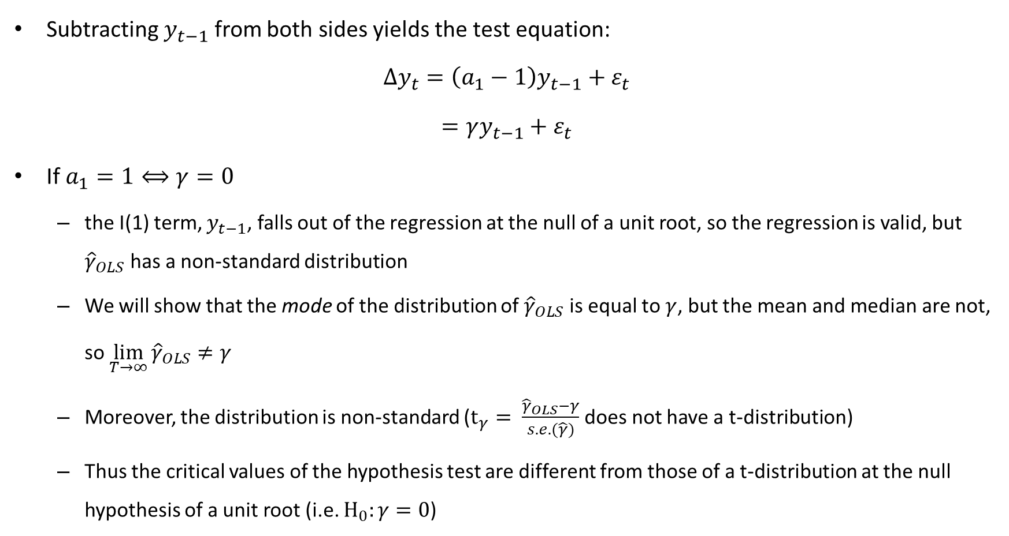
Test equation:
Subtracting $y_{t−1}$ from both sides yields the test equation:
$$∆y_{t}=\left(a_{1}−1\right)y_{t−1}+ε_{t}$$
$$=γy_{t−1}+ε_{t}$$
If $a_{1}=1⟺γ=0$
the I(1) term, $y_{t−1}$, falls out of the regression at the null of a unit root, so the regression is valid, but ${\hat{γ}}_{OLS}$ has a non-standard distribution
We will show that the mode of the distribution of ${\hat{γ}}_{OLS}$ is equal to $γ$, but the mean and median are not, so $\lim_{T→∞}{{\hat{γ}}_{OLS}}≠γ$
Moreover, the distribution is non-standard ($t_{γ}= \frac{{\hat{γ}}_{OLS}−γ}{s.e.(\hat{γ})}$ does not have a t-distribution)
Thus the critical values of the hypothesis test are different from those of a t-distribution at the null hypothesis of a unit root (i.e. $H_{0}:γ=0$)

Slide 72
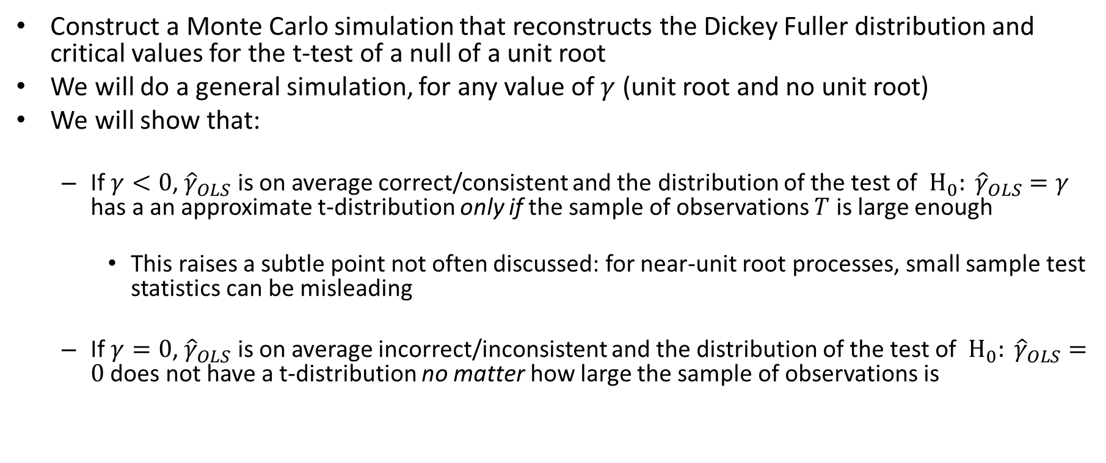
Exercise for the day:
Construct a Monte Carlo simulation that reconstructs the Dickey Fuller distribution and critical values for the t-test of a null of a unit root
We will do a general simulation, for any value of $γ$ (unit root and no unit root)
We will show that:
If $γ<0$, ${\hat{γ}}_{OLS}$ is on average correct/consistent and the distribution of the test of $H_{0}: {\hat{γ}}_{OLS}=γ$ has a an approximate t-distribution only if the sample of observations $T$ is large enough
This raises a subtle point not often discussed: for near-unit root processes, small sample test statistics can be misleading
If $γ=0$, ${\hat{γ}}_{OLS}$ is on average incorrect/inconsistent and the distribution of the test of $H_{0}: {\hat{γ}}_{OLS}=0$ does not have a t-distribution no matter how large the sample of observations is

Slide 73
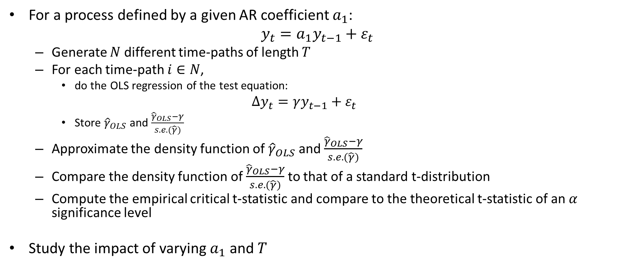
Monte Carlo Simulation
For a process defined by a given AR coefficient $a_{1}$:
$$y_{t}=a_{1}y_{t−1}+ε_{t}$$
Generate $N$ different time-paths of length $T$
For each time-path $i∈N$,
do the OLS regression of the test equation:
$$∆y_{t}=γy_{t−1}+ε_{t}$$
Store ${\hat{γ}}_{OLS}$ and $\frac{{\hat{γ}}_{OLS}−γ}{s.e.(\hat{γ})}$
Approximate the density function of ${\hat{γ}}_{OLS}$ and $\frac{{\hat{γ}}_{OLS}−γ}{s.e.(\hat{γ})}$
Compare the density function of $\frac{{\hat{γ}}_{OLS}−γ}{s.e.(\hat{γ})}$ to that of a standard t-distribution
Compute the empirical critical t-statistic and compare to the theoretical t-statistic of an $α$ significance level
Study the impact of varying $a_{1}$ and $T$

